Slide 1
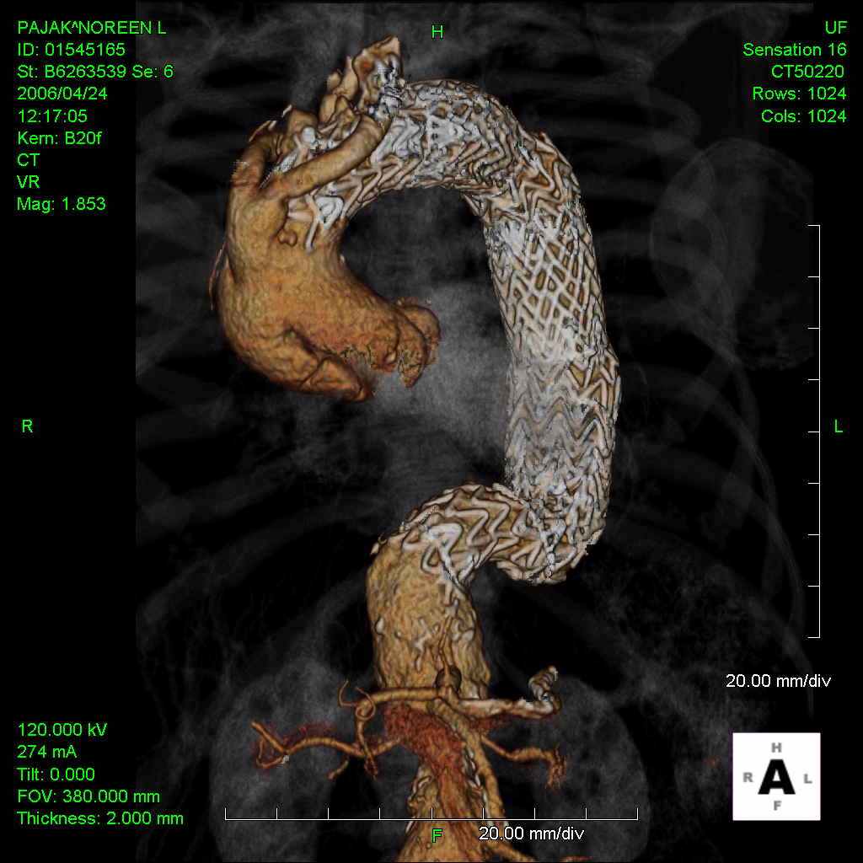
How do I prevent iatrogenic type A dissections?
Mark A. Farber, MD FACS
Chief, Division of Vascular Surgery
Professor of Surgery and Radiology
Director, Aortic Network
University of North Carolina
Chapel Hill, NC
Notes:
I would like to thanks the organizers for asking me to present on How to Prevent Iatrogenic Type A Dissections

Slide 2
Disclosures
Disclosures
 | Cook Medical | WL Gore | Getinge | Centerline Biomedical | ViTTA
Relationship | Research Support, Clinical Trials, Consulting | Clinical Trials, Consulting | Consulting | Consulting | Consulting, Clinical Trials
Received | Grants, Honoraria | Honoraria | Honoraria | Stock Options | Honoraria
Cook - Research Support, Consultant, Clinical Trials
WL Gore - Consultant, Clinical Trials
Medtronic - Clinical Trials, Consultant
Endologix - Clinical Trials, Consultant
Centerline biomedical - Shareholder, Consultant
Notes:
These are my disclosures

Slide 3
Short Answer….
Prevention depends upon two critical factors…..
Patient Selection
Device Selection
Notes:
Prevention of rTAD is predicated upon appropriate patient and device selection

Slide 4
Potential Causes of RTAD
Iatrogenic Injury to Ascending/Arch of the Aorta - Early
Device Related
Device configuration
Device implantation technique
Procedure Related
Zone of implantation
Oversizing
Ballooning at proximal attachment site
Progression of Disease - Late
Alterations in Aortic wall stress
Natural History
More often delayed presentation
Notes:
Iatrogenic injury typically occurs from either device related or procedure related issues including device configuration, implantation technique, location of the implantation zone, the degree of oversizing and ballooning at the proximal attachment site. Late causes of retrograde dissection are generally related to progression of disease and delayed in presentation. I will not be addressing the late causes in this presentation.

Slide 5
Retrospective analysis involving -
MOTHER Registry
Prospective trials at St. George’s Hospital
5 Trial (1010 pts)
RTAD: 16 pts (1.6%)
Pooled Systemic Review
51 reports (8884 pts)
162 pts with RTAD (1.8%)
Jan 2014
Notes:
The best overall analysis of causes of retrograde aortic dissection was from the UK. Dr. Thompson and his colleagues looked at near 10,000 patients involving both a local registry from their hospital as well as a systemic review of publications. The rates of rTAD were similar between the two groups.

Slide 6
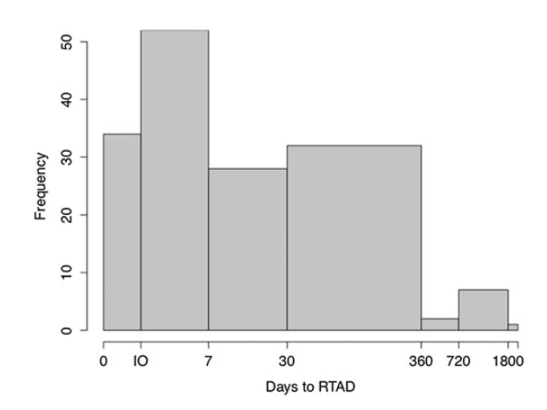
Pooled Analysis
Time to RTAD Occurrence
Incidence of RTAD: 1.7% (168/9894)
Associated 30-d Mortality: 33.6%
Frequency of Occurrence
Intra-Op: 21%
< 30d: 50%
>30 d: 29%
Higher for AD >CD > TAA
Not associated with Proximal Configuration
BS:NBS - 2.8% vs 1.9% p=.13 NS
Percentage
21%
50%
29%
Notes:
The overall incidence of RTAD was 1.7%. When it occurs associated with a significant mortality of 34%. Twenty-one percent of the time is was detected intra-operatively and an additional 50% of the cases were diagnosed before 30 days. Three factors were associated with the RTAD. It occurred more commonly when treating acute pathology especially dissections, and its prevalence surprising to some was not associated with the proximal device configuration, occurring similarly in those patients treated with a proximal bare stent and those treated with a non-bare-stent design

Slide 7
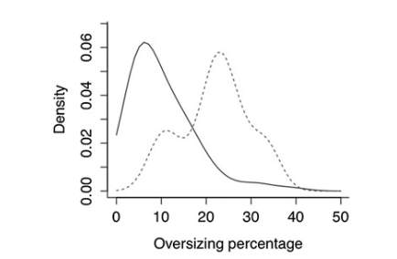
Impact of Oversizing
MOTHER Registry
RTAD was associated with oversizing >9%
OR increases 14% for each 1% increase in oversizing
Notes:
Lastly, they identified that the degree of oversizing as an important predictor in its occurance. In patients where the device was oversized by greater than 9% a 14% increase in risk occurred for each 1% increase in oversizing.

Slide 8
Comprised 50 publications
Patients: 8969
RTAD Incidence: 2.5%
Associated Mortality: 37.1%
Associated Characteristics
Acute Diss.>> Chronic Diss. >> TAA
Proximal Bare Stent >> NBS RR 2.26
Sept 2017
Notes:
More recently a systemic review waS done in 2017. It confirmed the significant mortality associated with its occurrence.

Slide 9
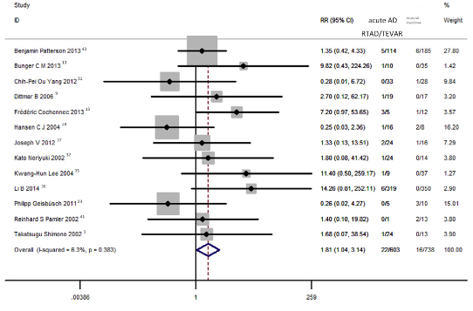
Comprised 50 publications
Patients: 8969
RTAD Incidence: 2.5%
Associated Mortality: 37.1%
Associated Characteristics
Acute Diss.>> Chronic Diss. >> TAA
Proximal Bare Stent >> NBS
Acute Dissection versus Chronic Dissection: RR 1.8
Sept 2017
Notes:
And that Acute dissections had a relative risk of 1.8 compared to chronic dissections

Slide 10
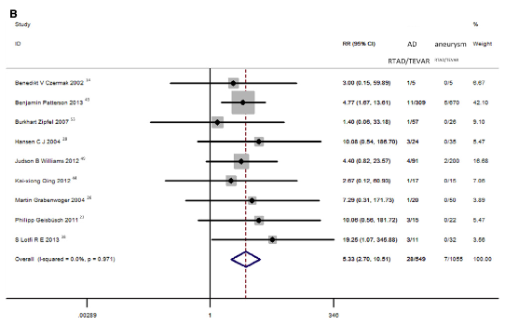
Comprised 50 publications
Patients: 8969
RTAD Incidence: 2.5%
Associated Mortality: 37.1%
Associated Characteristics
Acute Diss.>> Chronic Diss. >> TAA
Proximal Bare Stent >> NBS
Dissection versus Degen. Aneurysm: RR 5.3
Sept 2017
Notes:
As well as dissections imparting a relative risk of 5.3 compared to degenerative aneurysms for developing rTAD

Slide 11
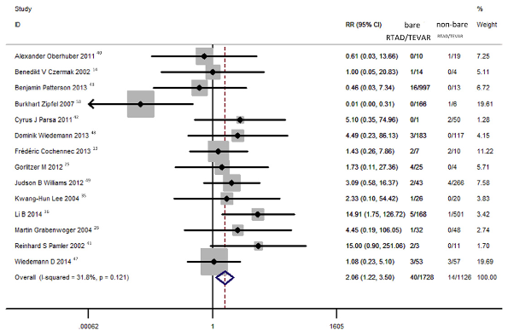
Comprised 50 publications
Patients: 8969
RTAD Incidence: 2.5%
Associated Mortality: 37.1%
Associated Characteristics
Acute Diss.>> Chronic Diss. >> TAA
Proximal Bare Stent >> NBS
Bare Stent versus Non Bare Stent RR 2.26
Sept 2017
Notes:
Interestingly they were able to show a correlation with proximal stent configuration with Bare stents imparted a 2.26 fold increase in risk compared to non bare stent designs

Slide 12
Series from 2012 - 2017
Patients: 187
RTAD 8% (15 pts)
Analysis:
Proximal Landing Zone 1 and 2
Ascending Aorta 4 cm
Jan 2019
Notes:
The only other significant risk factors that need to be aware of is that more proximal implantation sites and enlarged ascending aortas as associated with an increased risk of RTAD

Slide 13
Techniques to reduce RTAD
IVUS utilization (for dissection treatments)
Precise deployment
Implantation in non-dissected aorta (IMH and dissections)
Careful device size planning to avoid excessive oversizing
NO proximal ballooning
No blood pressure control maneuvers when working distal tot the L CCA
Do not exclude distal entry site prior to proximal exclusion
Delay repair if not symptomatic and treat in subacute phase
Notes:
Based on these findings the techniques that we employ at UNC to reduce the occurrence of Retrograde type A dissections are the following—
Routine use of IVUS, precise deployment techniques and careful selection of the proximal implantation site with advanced multiplanar reformatted images. Advanced imaging is also critical in selecting the best device size for treatment. We avoid proximal balloon dilatation and do not use blood pressure lowering techniques when working distal to the L CCA.

Slide 14
1. IVUS confirmation of TL access
Assessment of wire position prior to device insertion
Ascending/Arch assessment after TEVAR for RTAD
Notes:
Prior to implantation IVUS is critical in identifying proper wire placement. After implantation IVUS it also helpful for inspection of the ascending aorta and arch of the aorta to conform device location and the absence of a retrograde dissection

Slide 15
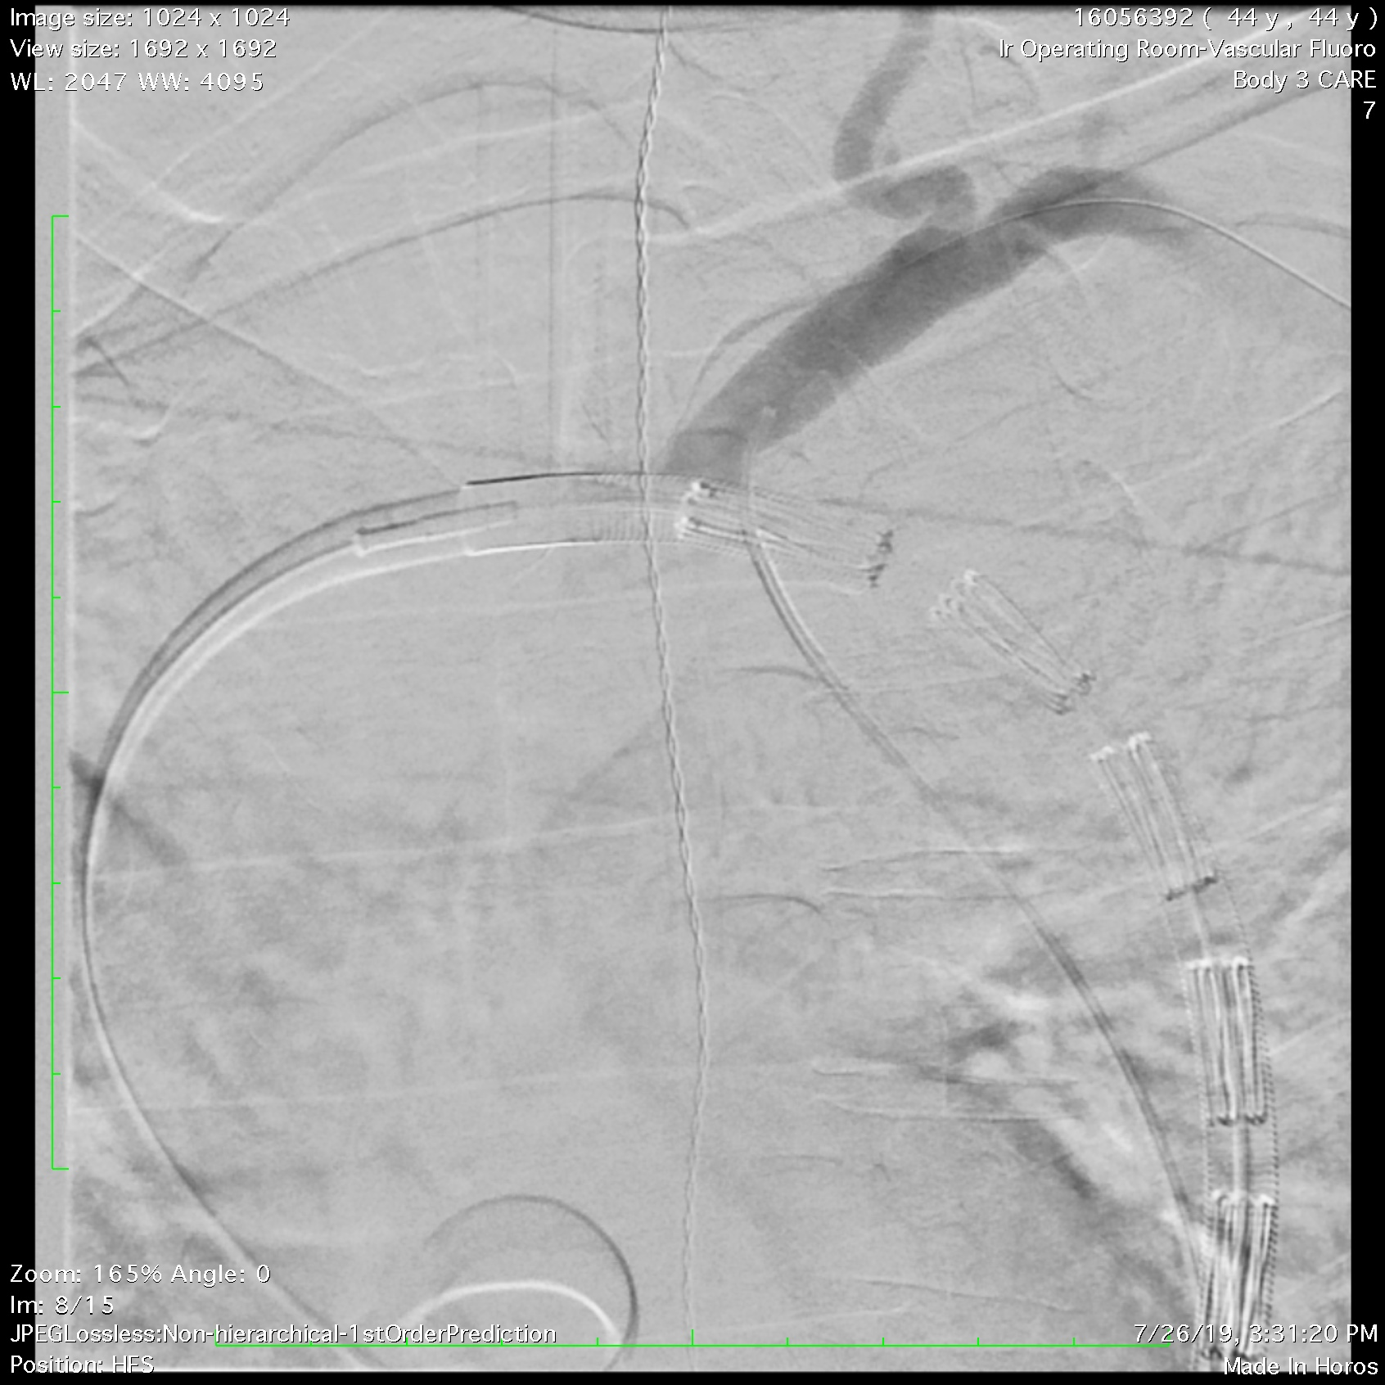
2. TEVAR - Proximal Device
Precise Deployment - Selective catheterization
Implantation into non-dissected aorta
Secondary access for precise deployment with need for manipulation
Maintain double curved Lunderquist on aortic valve and along greater curve
Catheter with 0.014 Sparticore in L SCA
Along greater curve
DC Lund
Aortic Valve
Notes:
For most cases we selectively catheterize the target branch vessel to enable precise device deployment and minimize the risk of stroke from arch manipulations. It is important to keep the stiff Lunderquist along the greater curvature to aid in this precision and avoid unnecessary movement of the device during deployment.

Slide 16
3. Oversizing
Oversizing based upon CPR imaging at area of proximal implantation zone
Typically Zone 2
Dissection ~10%
Aneurysms ~20%
B3 9
Typical TBAD
Landing Zone
Notes:
Device oversizing is based upon multiplayer reformatted images and we typically target 10% oversizing when treating dissections and 20% for aneurysmal disease. Advanced imaging analysis also helps correctly identify the region of non-diseased aortic for selecting the best proximal landing zone of the device.

Slide 17
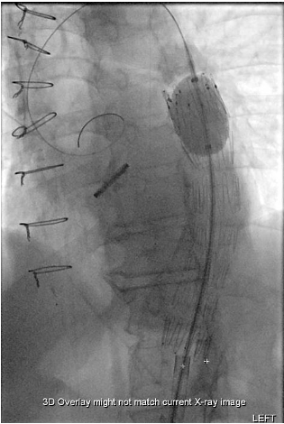
4. Ballooning - Avoid
Avoid unless proximal device issue exists
Type Ia endoleak (rare)
Severe device compression (rare)
Notes:
We avoid balloon molding in the proximal segment of the aorta unless there is a prominent type Ia endoleak or severe device compression that needs to be addressed. Since we typically plan for landing zones greater than 25 mm this is a rare occurrence.

Slide 18
Classification
Notes:
This past year the SVS and STS developed new reporting guidelines with respect to Type B aortic dissections and the acuity of disease.

Slide 19
5. Avoid treatment until subacute phase if possible
Notes:
We avoid treatment of asymptomatic patients in the hyper acute and acute periods. By delaying their intervention treatment until the subacute phase when prognostic indicators suggest future aneurysmal degeneration, we reduce the risks of developing a retrograde Type A dissection since the aortic is less friable during this period.

Slide 20
Summary
Routine use of IVUS
Appropriate landing zone in non-diseased aorta
Device sizing related to pathology being treated
Precise deployment techniques
No proximal aortic ballooning
Treatment delay in the subacute phase for asymptomatic pts.

Slide 21
Conclusion
RTAD is a serious complication of TEVAR
Low incidence (< 2%)
Severe implications- mortality > 30%
Prevention involves appropriate
Patient selection (timing)
Device selection (device size and implantation location)
Careful procedural technique
Notes:
In conclusion….. retrograde type A dissection is a serious complications with a low incidence. It is associated with a greater than 30% mortality. Prevention involved appropriate patient selection with respect to timing, device selection with respect to size and implantation location and careful procedural technique.

Slide 22
Title of Slide
5/4/17
Notes:
Thank you.

