Slide 1
When do I need to reline my bridging stents?
Said Abisi
St Thomas’ Hospital- London

Slide 2
Disclosures
Proctor/speaker/consultant
Cook, Bentley, Cryolife

Slide 3
Relining vs Extension
Relining is controversial, extension is often necessary
Different indications/purpose
Reporting should not be mixed

Slide 4
What is (was) the rational for relining?
“The previous experience and perceptions”
Improve the radial force of existing BSG.
Reduce the risk of kinking.
“Stabilise” the branch.
Adapting to the respiratory movements.

Slide 5
2015 Panuccio et al analysed al the performance of BSGs in FEVAR and BEVAR, almost two thirds were relined.
Branch-related complications were encountered and the authors concluded that it was not possible to prove the efficacy of relining.
2012 Chutters et al advocated routine relining to “stabilise” the BSG, improve the radial force and reduce the risk of kink.
reported 5% occlusion and stenosis rate and 5% vessel injury rate despite of relining.
To date there is no clinical or laboratory-based study that has justified the rationale for routine relining.
1- Panuccio G, Bisdas T, Berekoven B, et al. Performance of Bridging Stent Grafts in Fenestrated and Branched Aortic Endografting. In: European Journal of Vascular and Endovascular Surgery. 2015, pp. 60–70.
2- Reilly LM, Rapp JH, Marlene Grenon S, et al. Efficacy and durability of endovascular thoracoabdominal aortic aneurysm repair using the caudally directed cuff technique. J Vasc Surg 2012; 56: 53–64.

Slide 6
Effect of Branch Stent Choice on Branch-related Outcomes in Complex Aortic Repair. Mastracci et al ,Eur J Vasc Endovasc Surg 2016
Different practices up to 2014 using three different stent grafts:
Advanta V12
Fluency
Viabahn
The majority were reinforced with another device “ relining”
No difference in outcomes between primary choices of balloon expandable or self-expandable stent grafts.

Slide 7
Occlusions ✔️
Kinks ✔️
Fractures ✔️
Tracking difficulties ✔️
Deployment failures ✔️
Migration ✔️
Self expanding covered stents are relined with further self expanding covered stents

Slide 8
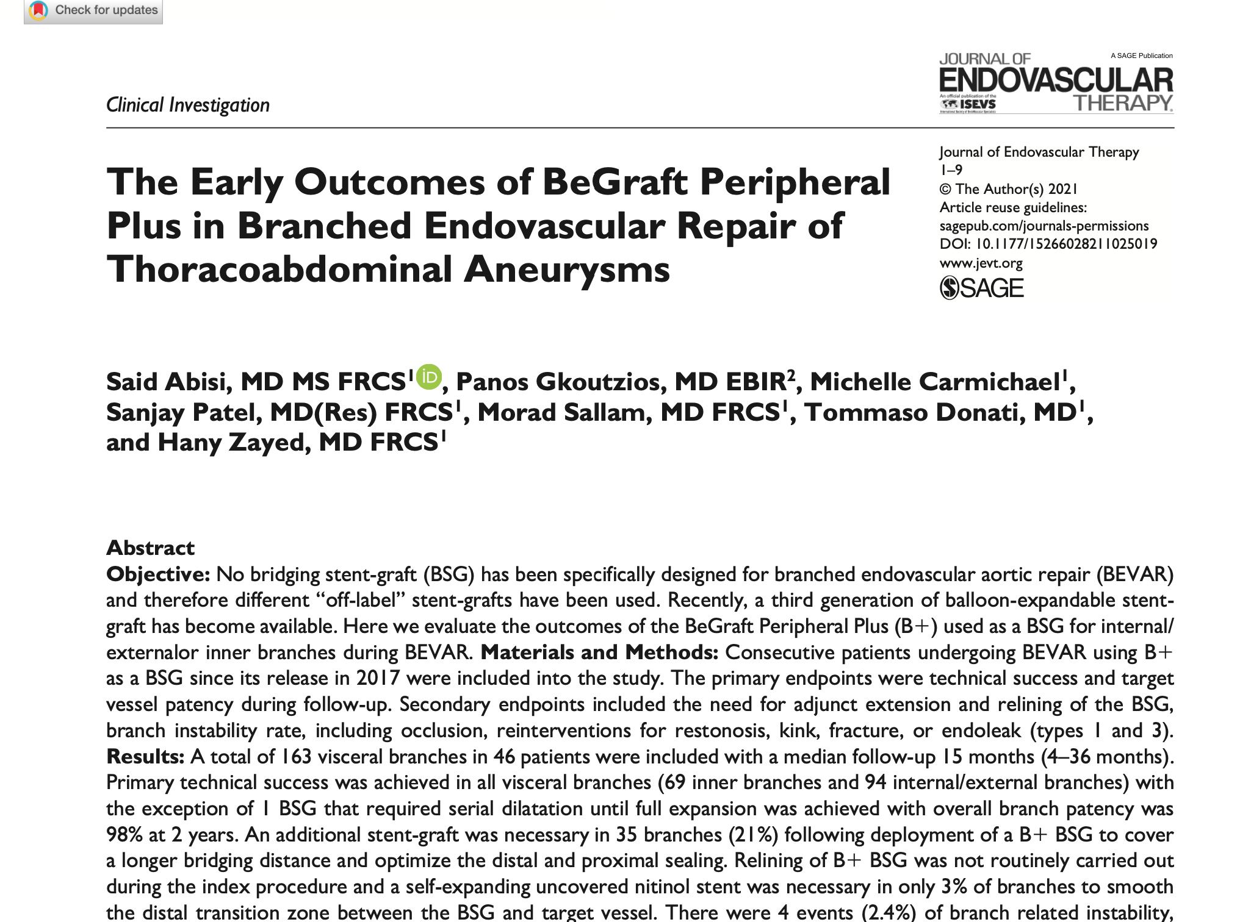
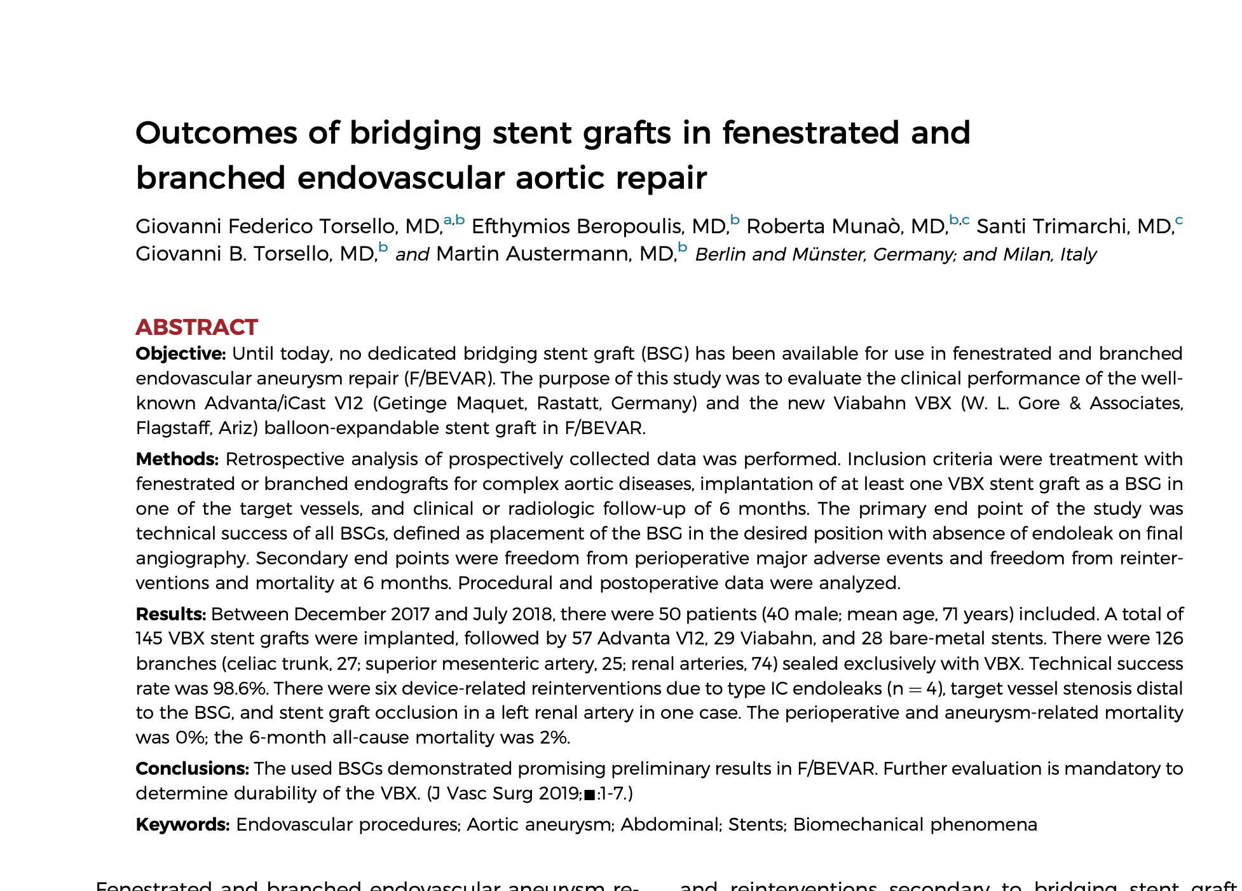
What has changed in the practice now 2021

Slide 9
No routine relining
Abisi et al JEVT 2021

Slide 10
Austermann et al JVS 2020

Slide 11
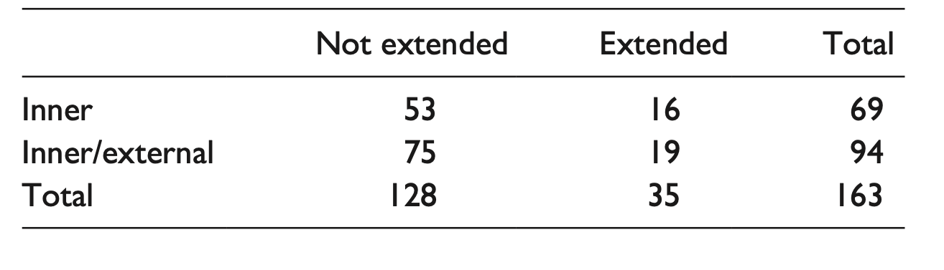
Extension for adequate seal
Minimum of 15 mm in the renal arteries, 20 mm in SMA and Coeliac
Avoid excessive extension
Up to 20% extension rate
Abisi et al JEVT 2021

Slide 12
Extension to smooth the distal end
Self-expanding uncovered nitinol stent into with the native target vessel , rare
To treat a small dissection
(n=2/162)
If angulations of the target vessels were deemed excessive
(n=3/162)
Abisi et al JEVT 2021

Slide 13
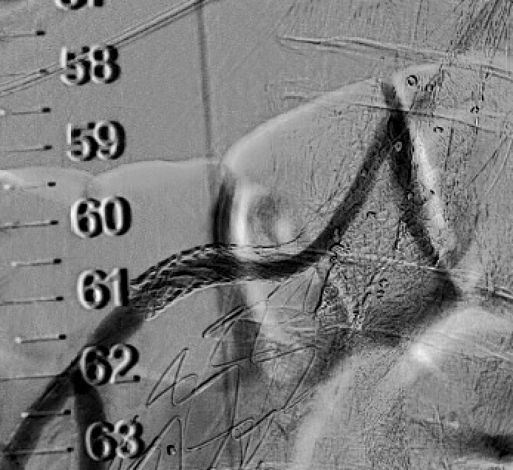
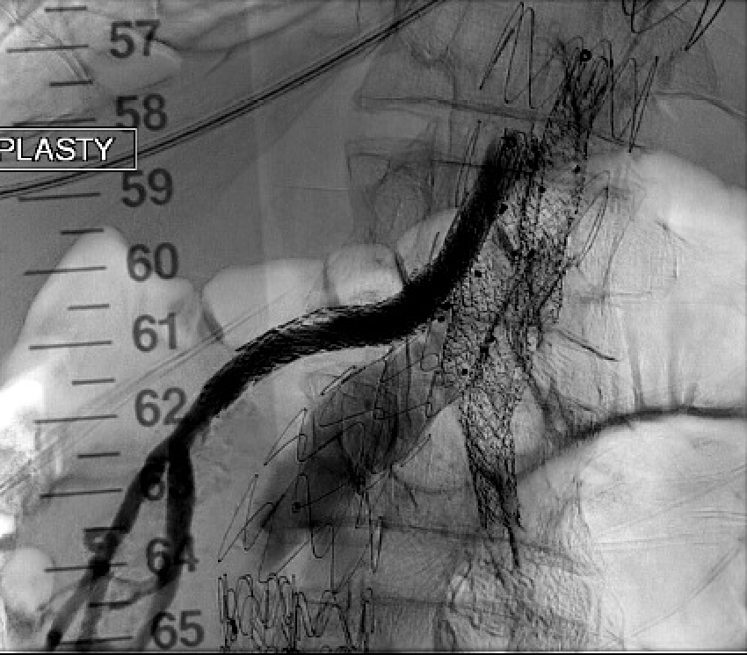
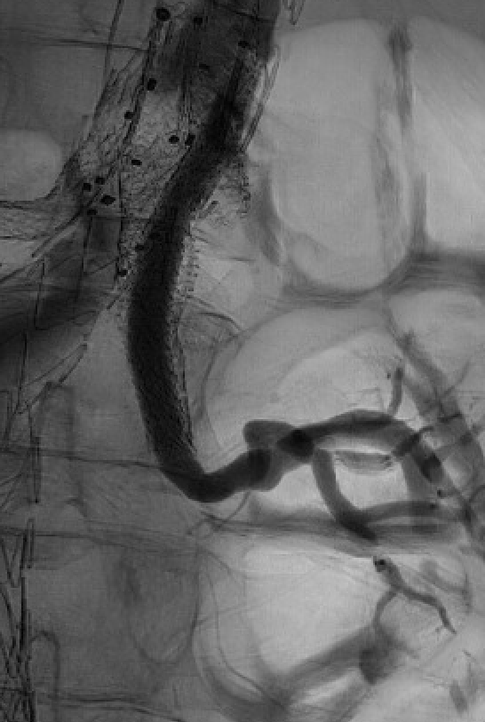
Still some role for relining…
Pre
Post
Pre
Post

Slide 14
Summary
Improved outcomes of the current bridging covered stents in BEVAR in both inner and internal/external branches.
Routine practice of relining BSG does not appear necessary in our experience.
Selective extensions might be required to achieve adequate seal in the target vessels or to smooth distal landing zone.

