Slide 1
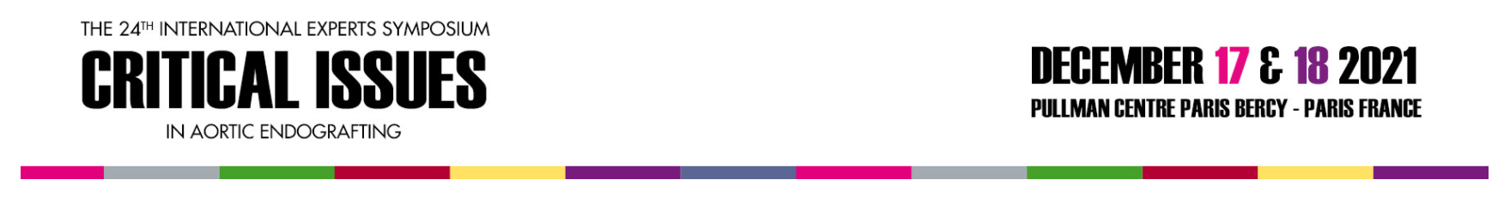
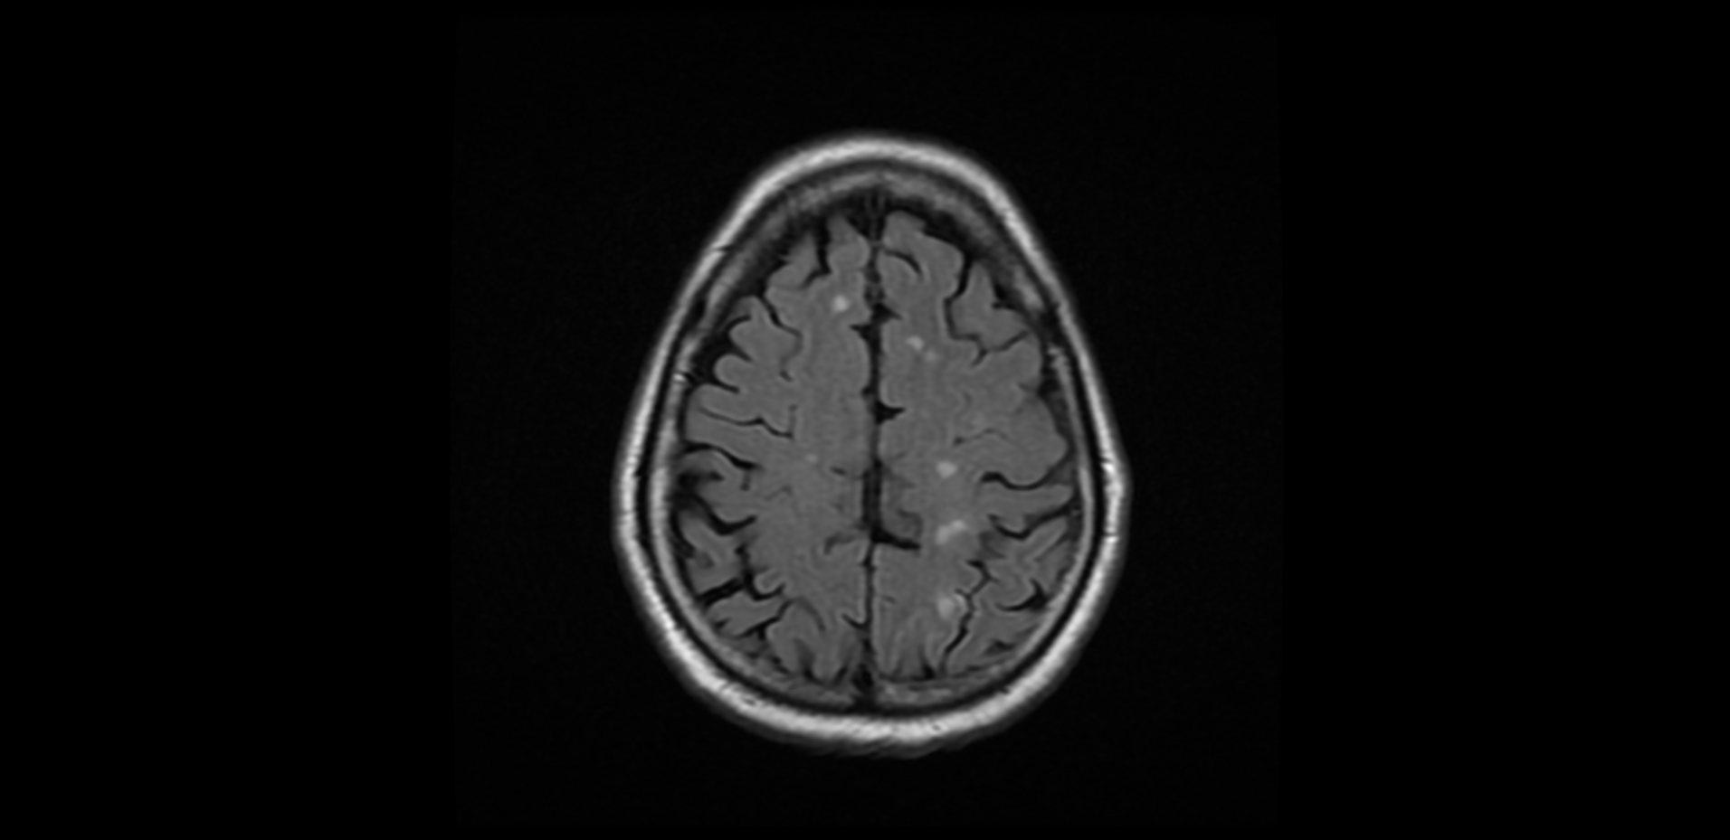



Lessons learned from brain imaging following TEVAR
RGJ Gibbs
Clinical Director Vascular Surgery
St Mary’s Hospital
Imperial College Healthcare NHS Trust

Slide 2
Disclosures
Research funding Gore Medical

Slide 3
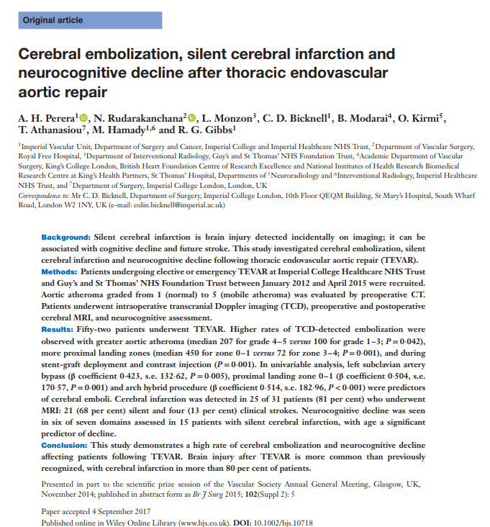
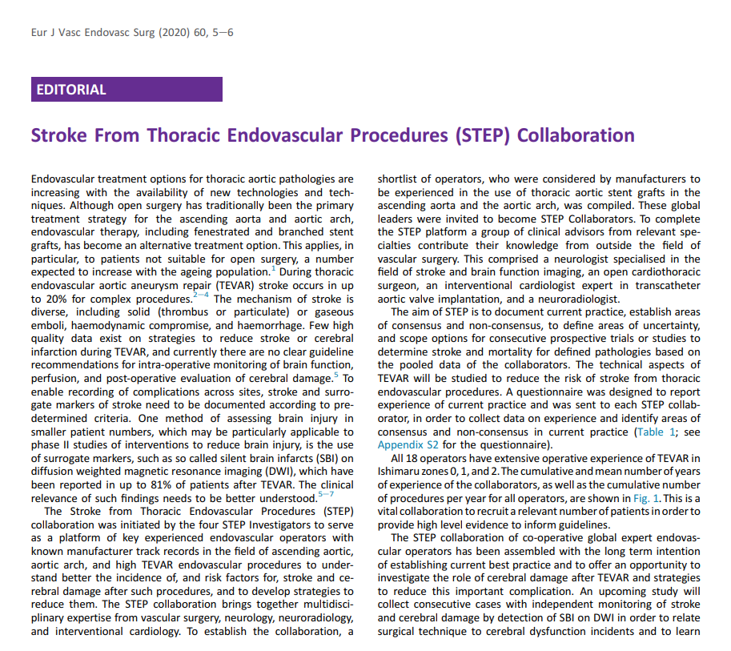
Notes:
Increasing recognition that both overt and covert cerebral infarction occurs during interventions in the arch and thoracic aorta
We found new DW MRI infarcts in 80% patients following TEVAR
Ongoing efforts to both define the mechanisms and mitigate the risk of strokes with preventive strategies and cerebral protection

Slide 4
Mechanism of Neurological Brain Injury in TEVAR: Transcranial Doppler
Periprocedural embolisation
Solid and gaseous embolisation
Transcranial doppler (TCD) of the MCA studies demonstrate several high risk phases of TEVAR when ‘high intensity signals’ – bright disturbances in the arterial signal indicative of solid and gaseous emboli
Positive correlation between solid and gaseous emboli to new acute infarcts detected on MRI
Notes:
Using TCD to detect embolic signals in the middle cerebral arteries tells us 2 things; time stamp for peri-procedural embolization – recognize the high risk moments during tEVAR, and software can now discriminate between particulate and gaseous embolisation based on reflectivity of solid and gas emboli
Solid TCD signals correlate with the size of new infarcts, and gaseous with number of small <3mm infarcts

Slide 5
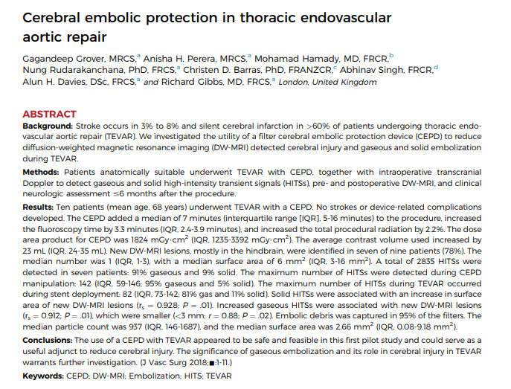
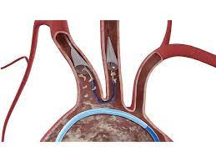
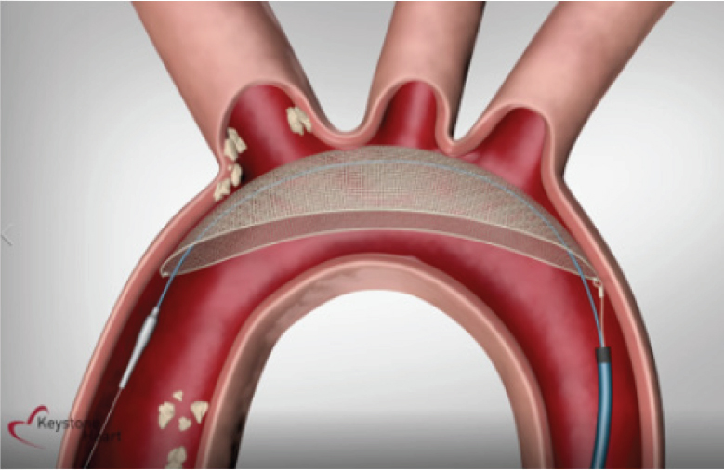
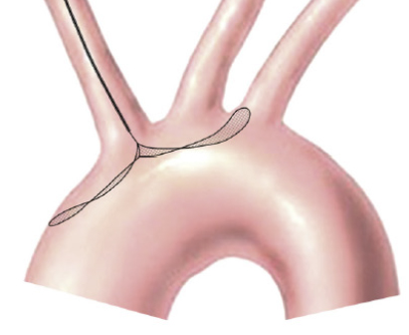
Cerebral Embolic Filters (CEPDs): Protection against solid embolisation
 | TriGuard | Embrella | Sentinel CEPD
Embolic protection mechanism | Deflection Pores of filter: 115 × 145 μm | Deflection Pores of filter: 100 μm | Filter and capture Pores of filter: 140 μm
Vessels protected | IA, LCCA, LSA | IA, LCCA | IA, LCCA
Access and delivery sheath | Femoral, 8Fr | Radial, 6F | Radial, 6Fr
Notes:
Cerebral embolic protection filters were initially designed to prevent solid embolisation to the brain from the aortic valve and arch during TAVI.
There are three main devices currently available
The triguard and Embrella are deflectors, are placed in the aortic arch and deflecting debris aware from the supra-aortic vessels.
The sentinel filter system has two filters connected to each other by an articulating sheath. The proximal filter sits I nthe IA and the distal filter guards the left common carotid artery. Both are designed to filter and capture debris before each reaches the brain.
It should be empahsied none of these were designed with TEVAR in mind.
The triguard and Embrella filters are clearly not compatible with TEVAR given that their placement within the arch would interefere with a tEVAR stentgraft.
The sentinel CEPD is therefore the most compatible for TEVAR work-flow. However, leaves the left subclavian artery and the posterior circulation unprotected
It is currently the only FDA approved embolic filter

Slide 6
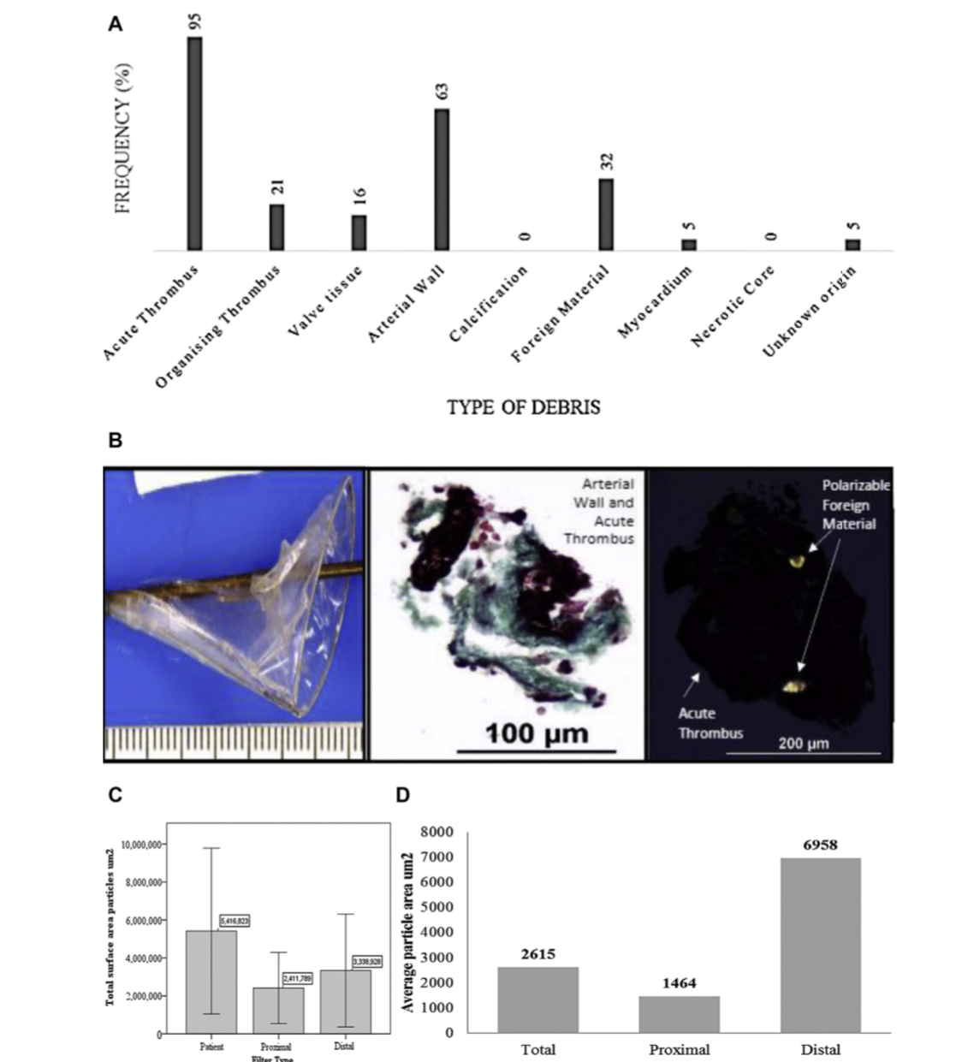
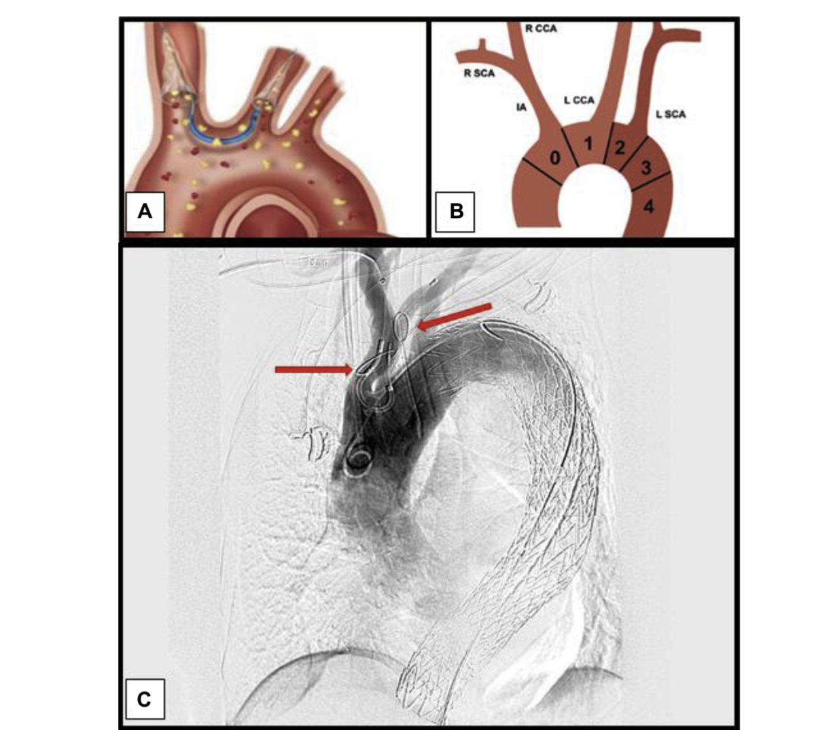
Pilot Study of 10 patients undergoing TEVAR + CEPD
Established feasibility and safety in Zones 2-4
Grover et al. 2019. JVS
Notes:
Safe and feasible method in 10 patients
One distal filter failed to deploy
Captured significant volume of debris en route to the brain

Slide 7
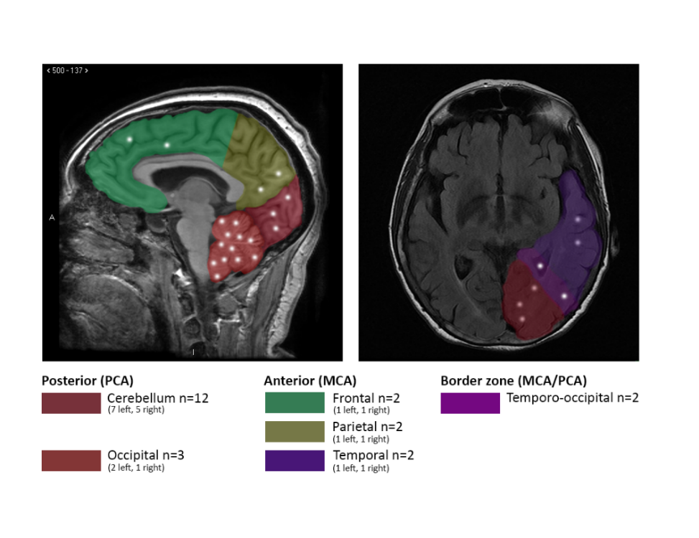
Pilot Study of 10 patients undergoing TEVAR + CEPD
Protected
7/9 (78%) 23 new lesions
Total SA=379mm2
Median SA= 6mm2 (3-16)
Unprotected
9/12 (75%) 55 new lesions
Total SA=1534mm2
Median SA=16mm2 (3-103)

Slide 8
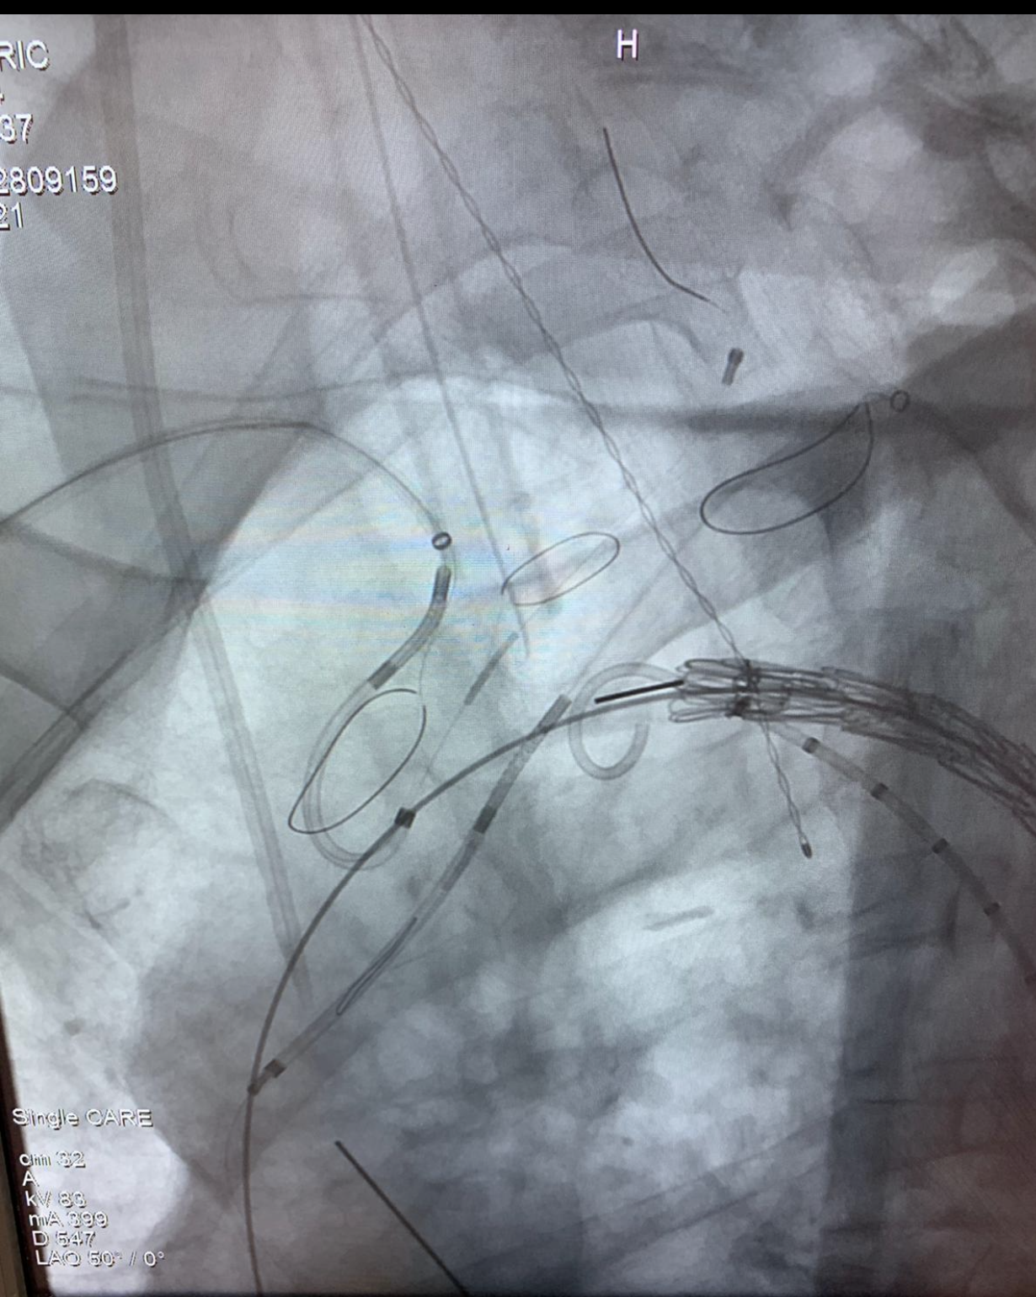
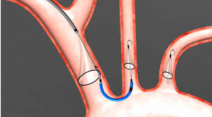
Three vessel filter protection
Prospective pilot study currently recruiting
LSA spider filter
Distal LCCA filter
Proximal IA filter
Notes:
To address the issue of the the unprotected LSA, we recently peformed the first three-vessel case, using a carotid filter ( Medtronic spider). The patient did not suffer a stroke. Furhter research in this area and larger studies are required to determine the safety and efficacy of 3 vessel protection to the brain.

Slide 9
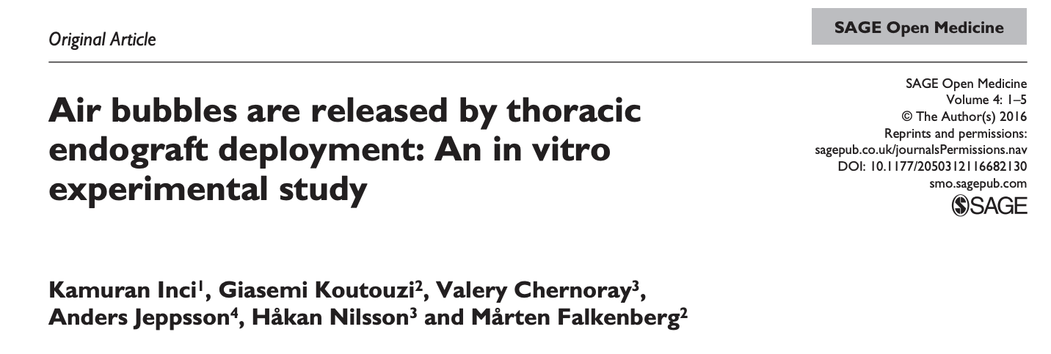
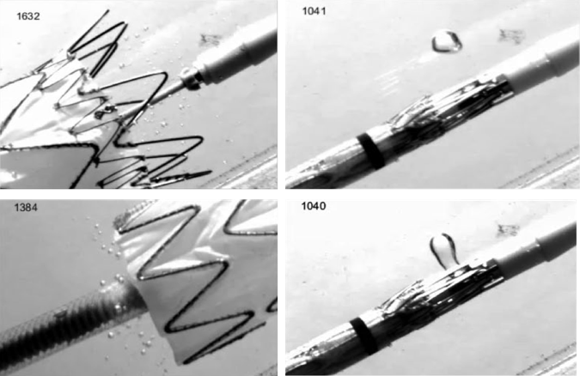
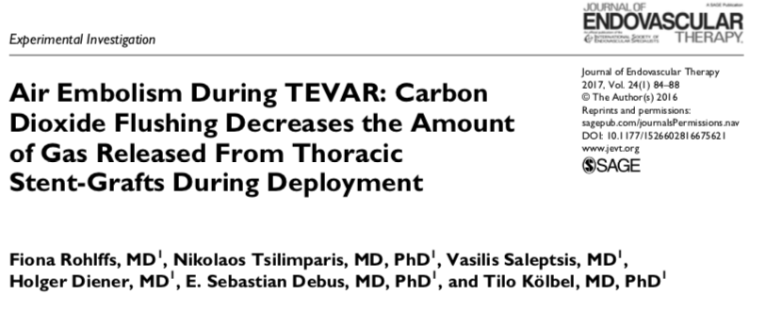
Gaseous embolisation
Notes:
The issue of gas/air release retained during the manufacturing processes wcih may then released during endograft deployment as a cause of neurological brain injury stoke and brain infarcts has gained intense interest in recent years.
Endografts are manufactured and packaged in room air conditions. According to IFU, they must be flushed with saline to de-air the device prior to use in the patient.
However, as devices become more low-profile and densely packed, they become harder to flush effectively and air pockets may become trapped within the endograft fabric.
Carbon-dioxide flushing has been proposed to be a better flushing agent rather than saline

Slide 10
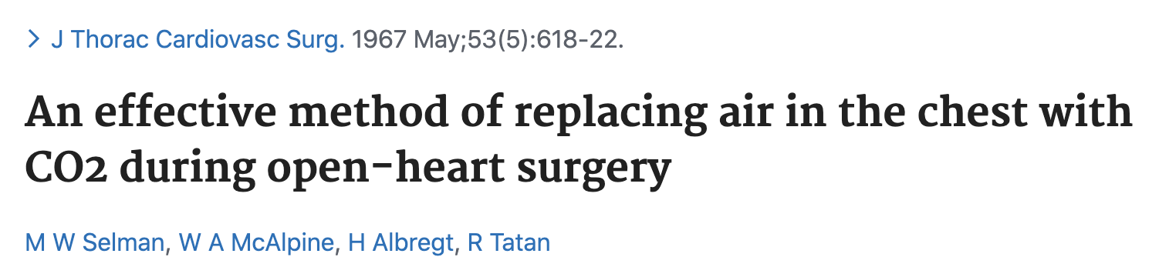
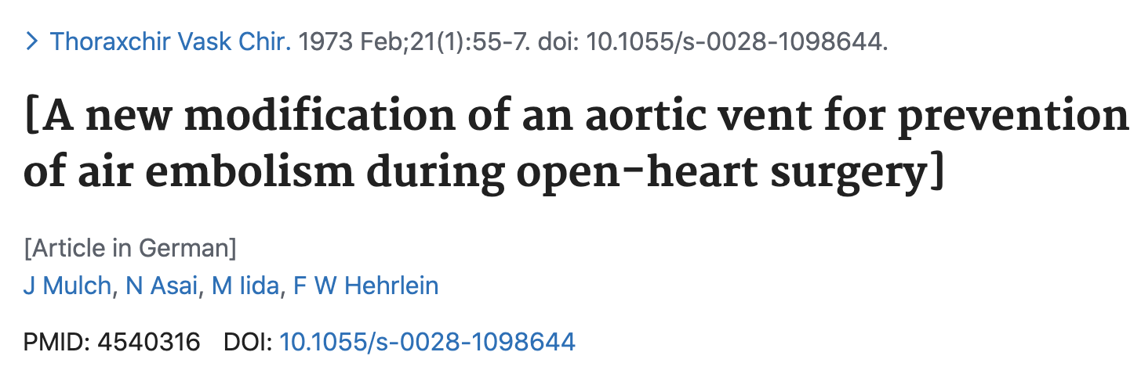
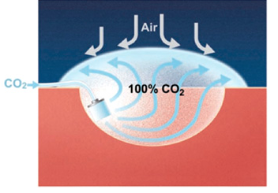
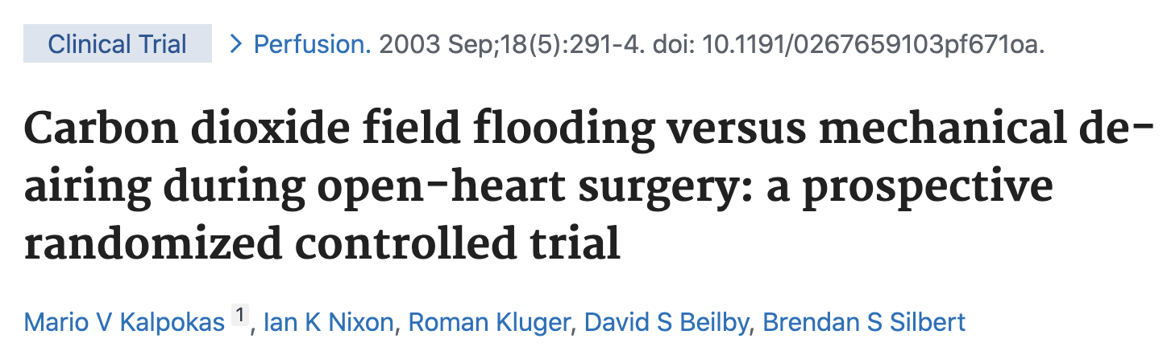
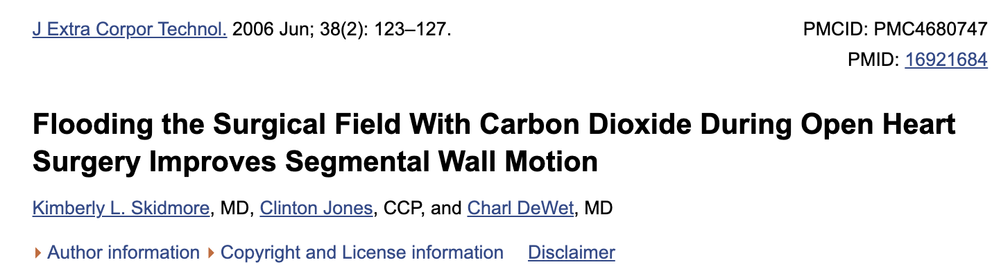
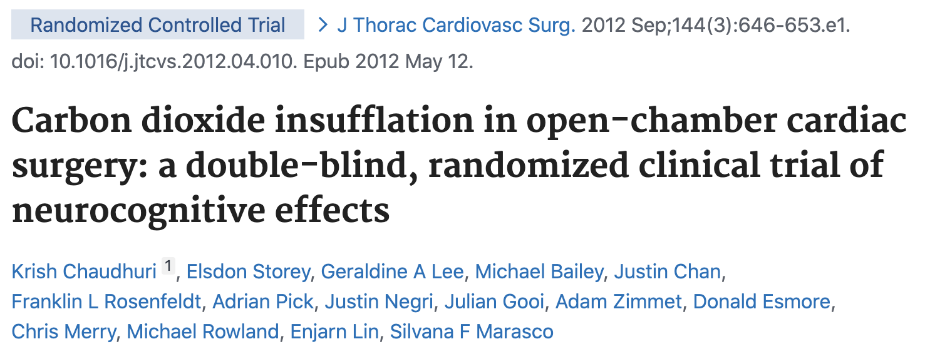
Carbon-dioxide flushing: Protection against gaseous cerebral embolisation
25 x denser to air
1.5 x soluble in blood than air
Notes:
The practice of CO2 flushing to prevent the clinical consequences of air emboli has been around since the 1960’s having first been used in open cardiac surgery to replace air within the heart with CO2, a soluble and less harmful gas.
CO2 is 2 times denser to air and therefore is able to displace air within a cavity and is 1.5 times more soluble in blood than air is, making it a safe purging agent.
Several studies in cardiothoracic surgery have demonstrated its efficacy at reducing air within the heart, and improved cognitive and cardiac function

Slide 11

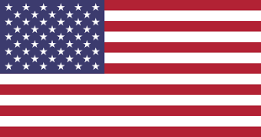

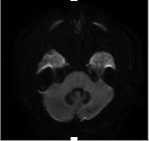
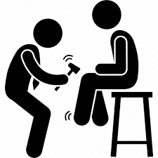
CO₂ flushing vs saline flushing of TEVAR stent-grafts
Prospective study- SMH, STH, BSW 187 consecutive patients undergoing TEVAR
1. CT angiogram
2. Post-operative MRI scans
3. Neurological examination
Notes:
Observational pilot study All patients underwent an Ct angiogram and blinded assessment of of arch atheroma and arch grade, post-operative MRI scans that were reported by a blinded neuroradiologist, and neurological examination with all clinical events confirmed by a neurologist.

Slide 12
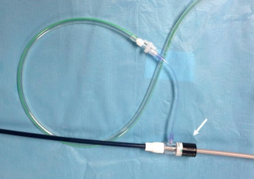
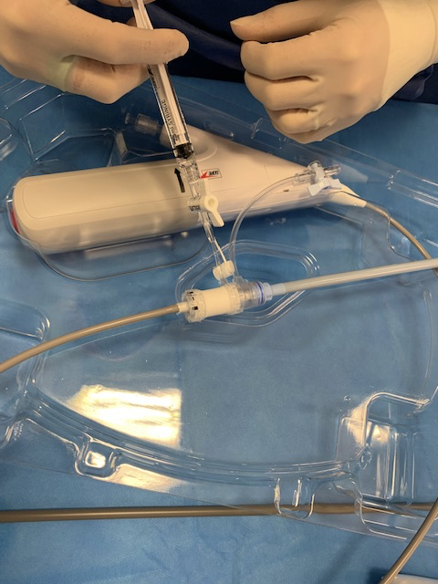
CO₂ flushing technique
Developed at Imperial College London, device specific due to sheathed and non-sheathed devices
2 bar pressure for two minutes (uncontrolled flow-rate) followed by 60mls saline (standard of care)
Sheathed device
Unsheathed device
Notes:
We went on to in a series of benchtop experimental models to firstly confirm that stentgrafts release air, and to then determine whether CO2 flushing was a better purging agent that standard saline. We were able to undertake testing on Medtronic and Ctag gore devices

Slide 13
Results: Baseline demographics and procedural characteristics
Characteristics | Saline (n=112) | C02 (n=75) | P-value
Demographics
Age (years) | 66.8 ± 14 | 69.8 ± 12 | 0.188
Male | 71 (63) | 52 (69) | 0.401
Co-morbidities
Hypertension | 85 (76) | 67 (89) | 0.021
Atrial fibrillation | 10(9) | 5 (7) | 0.670
Ischaemic heart disease | 22(20) | 26 (35) | 0.021
CABG/coronary stents | 7 (6) | 8 (11) | 0.216
Valve procedures | 7 (6) | 3 (4) | 0.572
Hypercholestrolaemia | 55 (49) | 47 (63) | 0.068
Diabetes mellitus | 11(10) | 7 (9) | 0.691
Chronic obstructive pulmonary disease | 25(22) | 29 (39) | 0.016
Chronic kidney disease (eGFR < 60ml/min) | 34(30) | 13 (17) | 0.044
Previous TIA/CVA | 15 (13) | 6 (8) | 0.252
Previous thoracic surgery | 31(28) | 9 (12) | 0.010
Previous abdominal surgery | 6 (5) | 4 (5) | 0.994
Smoking history | 64(58) | 50 (67) | 0.216
Medication
Anticoagulation | 11(10) | 14 (19) | 0.106
Antiplatelets | 56 (51) | 48 (64) | 0.078
Statins | 67 (60) | 51 (68) | 0.256
Fazekas scale: PVWM
0-1 | 30 (41) | 28 (43) | 0.814
2-3 | 43 (59) | 37 (57) | 0.814
Fazekas scale: DWM
0-1 | 35 (48) | 34(52) | 0.609
2-3 | 38(52) | 31(48) | 0.609
*Arch atheroma grade
3-4 | 48(43) | 22 (31) | 0.112
*Arch grade
1 | 32 (29) | 26 (37) | 0.217
2 | 37 (4) | 35 (50) | 0.029
3 | 41(37) | 9 (13) | 0.0003
Characteristics | Saline (n=112) | CO₂(n=75) | P value
Indication
Chronic degenerative aneurysm Atherosclerotic aneurysm Penetrating aortic ulcer Coarctation | 68 (61) 50 (45) 10 (9) 8 (7) | 43 (57) 36 (48) 6(8) 1(1) | 0.645
Chronic type b dissection aneurysm | 17(15) | 14 (19) | 0.530
Acute type b dissection | 15(13) | 12 (16) | 0.619
Other (mycotic aneurysm, trauma, endoleak relining) | 12(11) | 6(8) | 0.537
Emergency | 42 (38) | 22 (29) | 0.249
VPOSSUM mortality | 6.9 ± 6.7 | 6.5 ± 12.5 | 0.807
VPOSSUM morbidity | 56.4 ± 20.1 | 44.0 ± 24.5 | 0.001
Ishimaru Proximal landing Zone
0 | 6 (5) | 5 (7) | 0.709
1 | 9 (8) | 2 (3) | 0.126
2 | 40 (36) | 15 (20) | 0.021
3 | 38(34) | 42 (56) | 0.003
4 | 19 (17) | 11 (14) | 0.675
Management of the LSA
Uncovered | 58 (53) | 53 (71) | 0.014
Covered | 13(12) | 6 (8) | 0.401
Revascularized | 39 (36) | 16 (21) | 0.039
Notes:
This was not randomized and therefore there were some potential confounds including PLZ

Slide 14
Results: Neurological and DW-MRI outcomes
Characteristic | Saline (n=112) | CO₂ (n=75) | P-value
Incidence of new infarction on any cerebral imaging | 57/77 (74) | 28/65 (43) | 0.0002
Clinical stroke | 14(13) | 5(7) | 0.196
Incidence of new infarction on DW-MRI | 53/73 (73) | 28/65(43) | 0.0004
Median total number of DW-MRI infarcts (range) | 2(0-25) | 0(0-31) | 0.0003
Median total number of DW-MRI infarcts: anterior circulation (range) | 0(0-8) | 0(0-23) | 0.209
Median total number of DW-MRI infarcts: posterior circulation (range) | 2(0-19) | 0(0-7) | 0.012
Median total number of DW-MRI infarcts: borderzones (range) | 0(0-11) | 0 (0-3) | 0.001
Median total surface area of lesions (range, mm²) | 10 (0-2912) | 0 (0-1679) | 0.007
Median total surface area of DW-MRI infarcts (range, mm²): anterior circulation | 0 (0-2520) | 0 (0-336) | 0.330
Median total surface area DW-MRI infarcts (range, mm²): posterior circulation | 1(0-2844) | 0(0-1671) | 0.010
Median total surface area of DW-MRI infarcts(range, mm²): borderzones | 0 (0-594) | 0 (0-52) | 0.002
Median maximum diameter of DW-MRI infarcts (range, mm) | 3(0-88) | 0 (0-45) | 0.028
Median number of left sided DW-MRI infarcts | 1(0-22) | 0(0-9) | 0.00009
Median surface area of left-sided DW-MRI infarcts (mm²) | 6(0-2541) | 0 (0-276) | 0.001
Median number of right sided DW-MRI infarcts | 0(0-16) | 0(0-26) | 0.012
Median surface area of right-sided DW-MRI infarcts (mm²) | 0(0-2776) | 0 (0-1671) | 0.0002
No difference in clinical stroke
Significant reduction in the incidence of new DW-MRI infarcts with CO₂ flushing
Significant reduction in the total number of new DW-MRI infarcts
Significant reduction in the surface area of new DW-MRI infarcts
FEWER and SMALLER DW-MRI infarcts with CO₂ flushing
Notes:
CO2 reduces the embolic burden to the brain from TEVAR

Slide 15
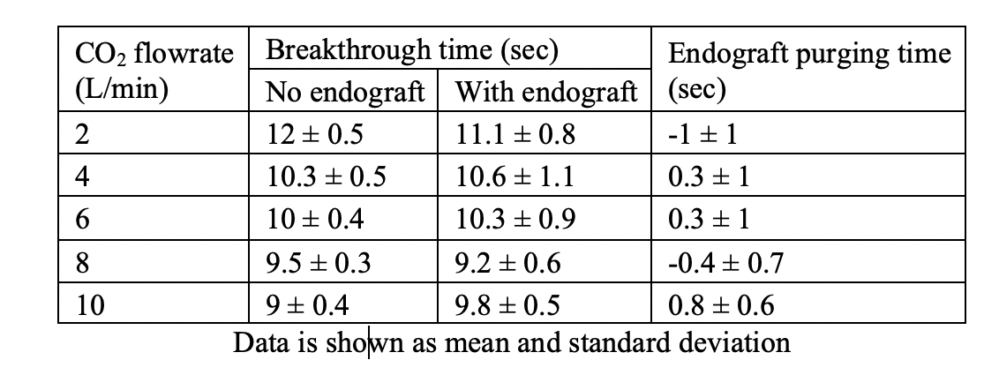
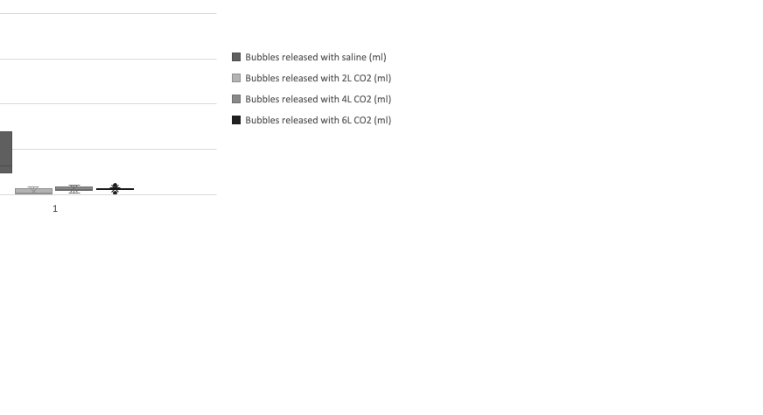
Refinement of the flush technique: Benchtop experimentation
CO₂ takes less than 60 seconds to reach the end of the stent-graft and reach a steady state (mass spectrometry)
Optimal CO₂ flushing is 2L, 4bar pressure for 1 minute
CO₂ flush at any flow-rate resulted in significantly less gas release compared to saline
2L CO₂ flush resulted in significantly less gas released than 4L and 6L CO₂
No significant difference between 4L and 6L CO₂ flush
Flushing at lower flow rate is better than a higher flow rate
Notes:
Very important to standardize C02 flush technique :We went on to in a series of benchtop experimental models including mass spectrometry to look at gas composition
Optimal parameters to purge stent graft is 2L at 4 bars for 1 minute
to firstly confirm that stentgrafts release air, and to then determine whether CO2 flushing was a better purging agent that standard saline. We were able to undertake testing on Medtronic and Ctag gore devices

Slide 16
INTERCEPTevar: INTERvention with Cerebral Embolic Protection in TEVAR
ClinicalTrials.gov Identifier: NCT03886675
RCT TEVAR-CO2 vs TEVAR-S
Multi-center (UK, US, New Zealand)
Multi-graft
Standardized Saline/IFU vs CO₂ de-airing techniques
36 month recruitment period
Primary endpoint: Incidence of new DW-MRI infarcts
Secondary endpoints: Stroke, number and size of new DW-MRI infarcts according to defined cerebrovascular territories
Important clinical question to answer including burden of solid embolization
Notes:
Also doing this with Imperial cardiology colleagues in twin study – INTERCEPT TAVI

Slide 17
Conclusion
Spectrum neurological brain injury following TEVAR: STROKE and acute ‘silent’ brain infarcts
Mechanism of injury is embolic as evidenced on neuroimaging and TCD findings
Solid and gaseous emboli are pathogenic
TEVAR specific neuroprotective adjuncts against both are required
Further study needed to determine the applicability and efficacy of CO₂ flushing and/or filters to prevent peri-procedural cerebral embolisation during TEVAR
Further study needed to determine the impact of reducing embolic burden to the brain on stroke, brain infarcts and clinical sequelae - delirium, neurocognitive decline, QOL

Slide 18
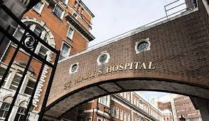





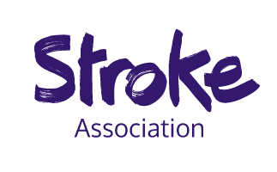

Preventing Cerebral Embolism in TEVAR
L Hanna, A Abdullah, A Singh, W Montgomery, C Bicknell, M Salam, B Modarai, S Abisi,
D Gable, M Hamady RGJ Gibbs
Imperial College London, Imperial Healthcare NHS Trust
St Thomas’s Hospital, London
Baylor Scott and White, Plano, Heart hospital

