Slide 2
What is a large Infra-Renal neck?
Should EVAR be performed in large necks?
Mark Tyrrell
(No disclosures)

Slide 3
What’s the Point?
“It’s the DURABILITY stupid!”

Slide 5
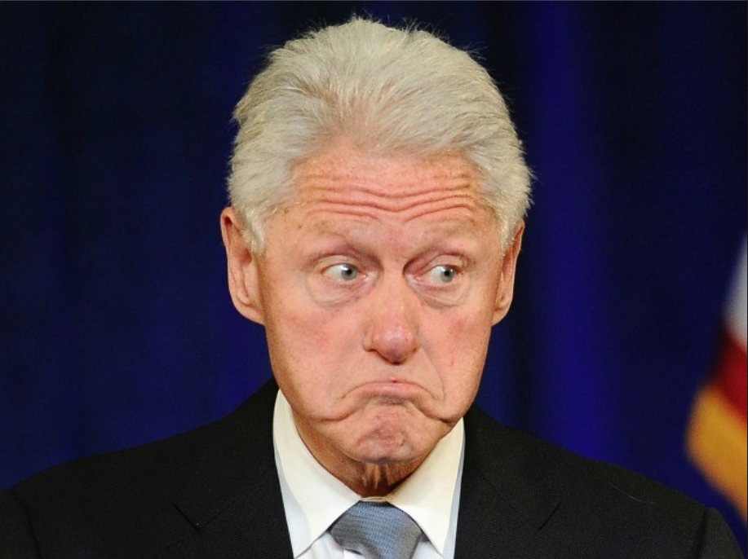
NICE 2018
“1.5.3 Do not offer endovascular repair (EVAR) to people with an unruptured infrarenal AAA if open surgical repair is suitable.
1.5.4 Do not offer EVAR to people with an unruptured infrarenal AAA if open surgical repair is unsuitable because of their anaesthetic and medical condition.
1.5.5. Do not offer complex EVAR to people with an unruptured AAA if open surgical repair is a suitable option, except as part of a randomised controlled trial comparing complex EVAR with open surgical repair.
1.5.6 Do not offer complex EVAR to people with an unruptured AAA if open surgical repair is unsuitable because of their anaesthetic and medical condition.”

Slide 6
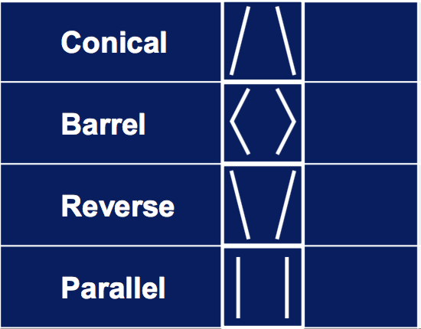
The Hostile Neck
What is the wisdom in ”pushing the envelope” for standard EVAR in anatomies that are known to be prone to early failure?
Short necks…
Conical/Barrel/Funnel necks
Thrombus burdened necks
Calcified necks
Angulated necks
LARGE necks
Anything off IFU
(Likely to affect 15-20% of AAA)

Slide 7
Definition of the LARGE neck
Graft manufacturers IFUs:
Cook ZIMB 36 (29-32mm OD)
Cook TFFB 36 (29-32mm OD)
Gore Excluder 35 (30-32mm ID)
Gore Conformable 36 (30-32mm ID)
Medtronic Endurant 36 (32mm)
etc., etc.
Off-the-shelf max treatable IR diameter = 32mm

Slide 9
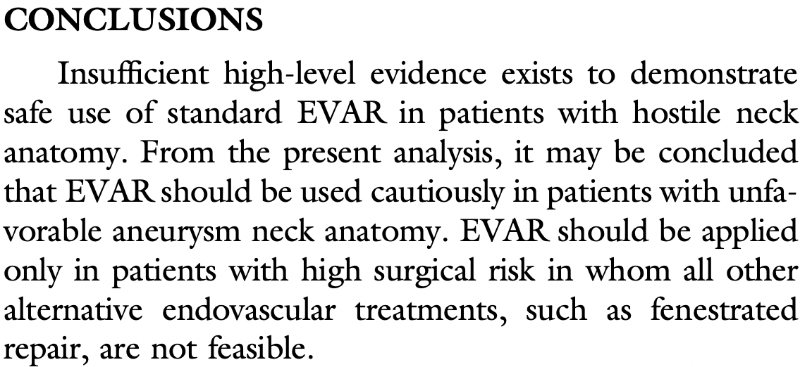
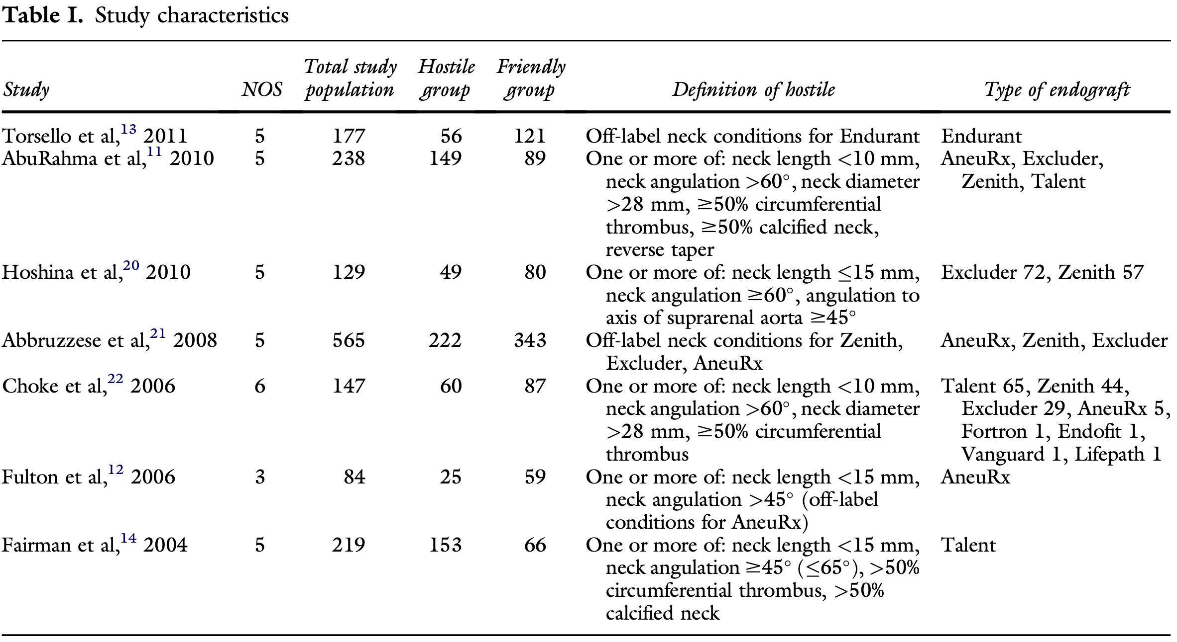

Slide 10
60% of the AAAs in the study <55mm diameter
At 5 years post EVAR, 41% of AAA sacs showed >5mm enlargement

Slide 11
June 2017

Slide 12
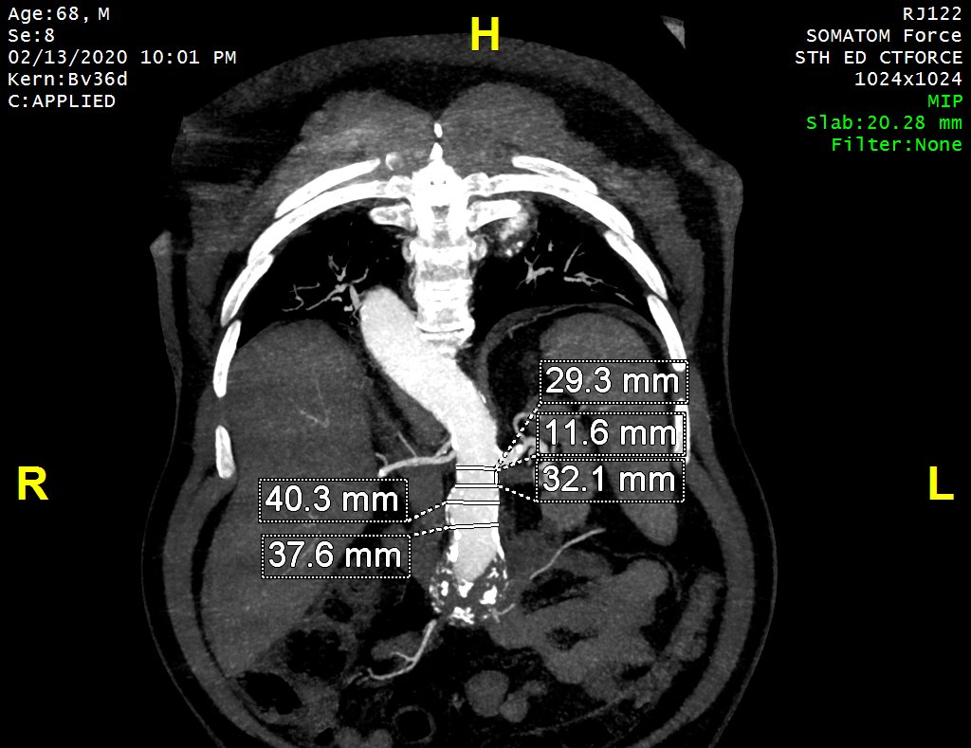
Definition of the LARGE neck
>32mm is off OTS IFU
+ >28 (or 30)mm

Slide 13
Accepting the Greenberg principle (that all aortas will fail given long enough)
We need a strategy:
Avoid short-term success in a long-term patient
Especially where retrieval = complex OSR in an older and frailer patient
Plan to match EVAR & Patient durability with the option to fail from one EVAR solution to another
Ideally the most challenging operation when the patient is fittest (youngest)
GiRFT!

Slide 14
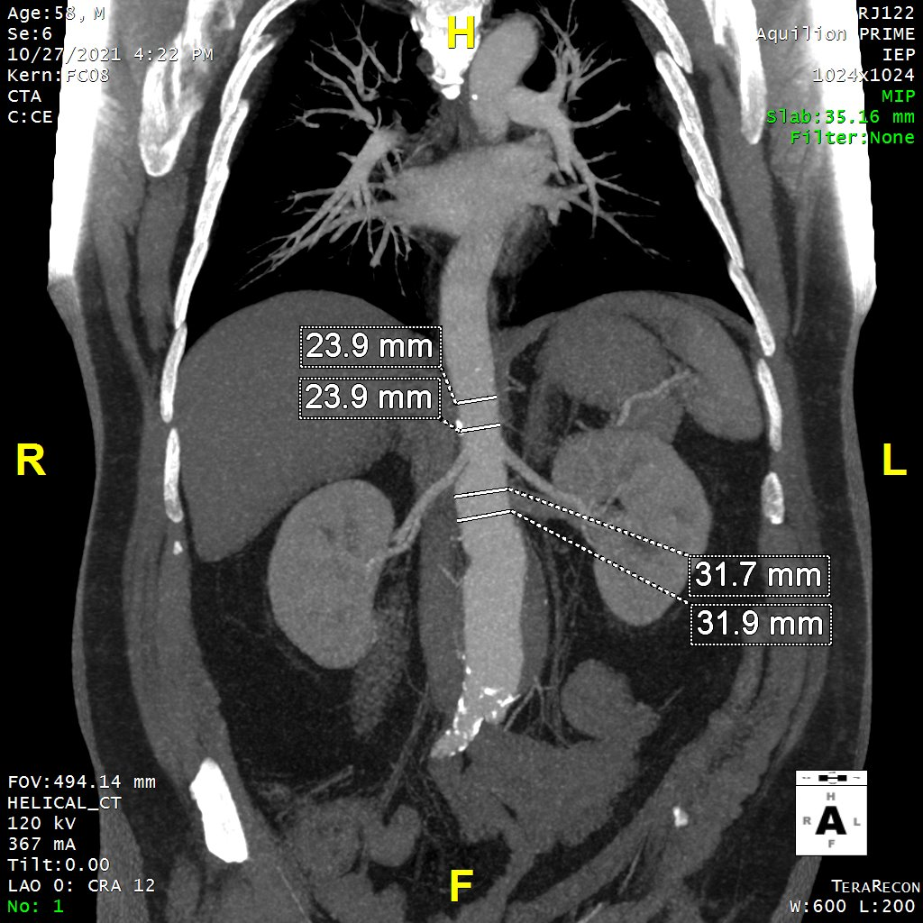
Imponderables
Where might the IFUs be optimistic?
Big necks that are on IFU
Gender specific?
Body size specific?
Relative to “healthy” aorta?
Age/Life-span specific?
Special circumstances?
RAAA

Slide 15
To Answer the Questions:
What is a large Infra-Renal neck?
Definitely >32mm
Probably >30mm
Possibly >28mm
Should EVAR be performed in large necks?
Sometimes
(….and only after due consideration…)

Slide 16
Thank You!

