Slide 1
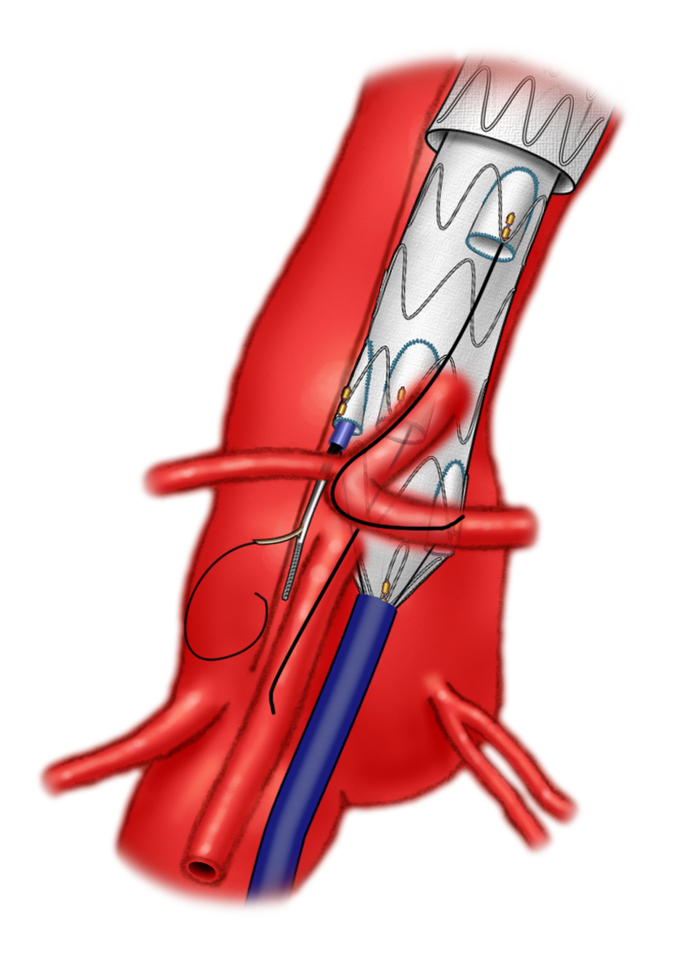
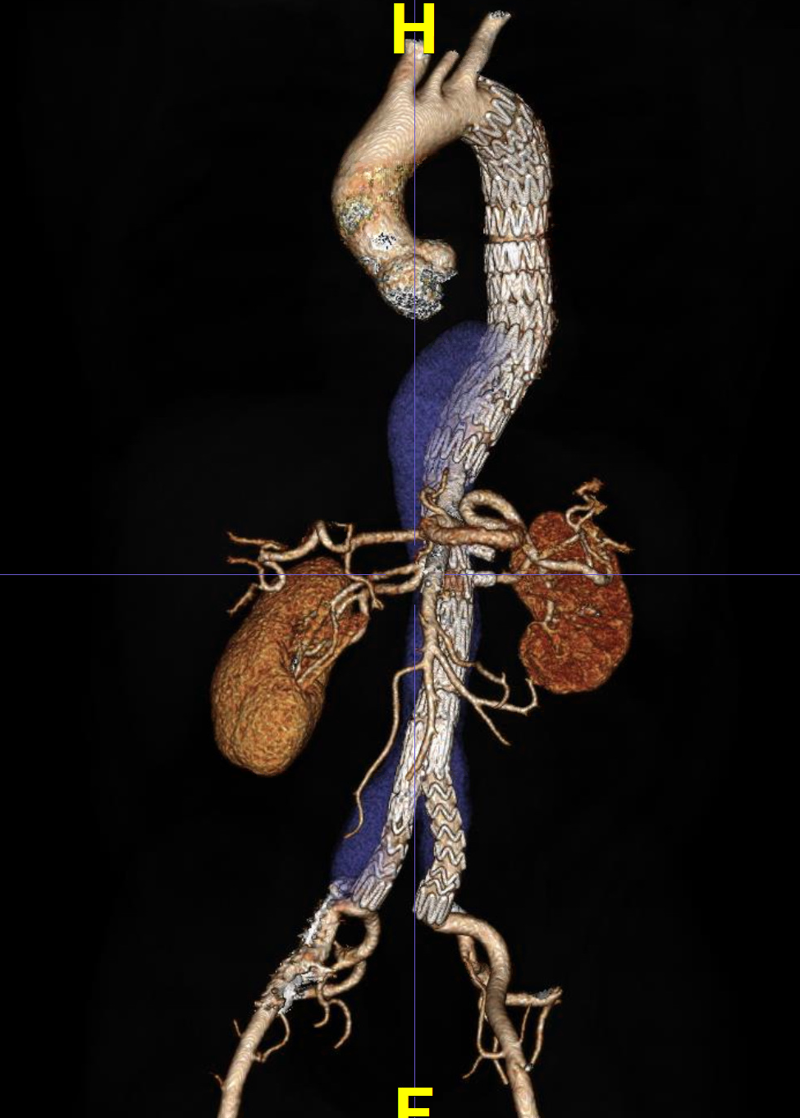
What to do about persistent flow in the false lumen after FBEVAR
Mark A. Farber, MD
Chief, Division of Vascular Surgery
Director, UNC Aortic Network
Professor of Surgery and Radiology
University of North Carolina
Chapel Hill, NC
Notes:
I would like to thank the organizers for asking me to present on managing persistent false lumen perfusion after fenestrated and branched EVAR

Slide 2
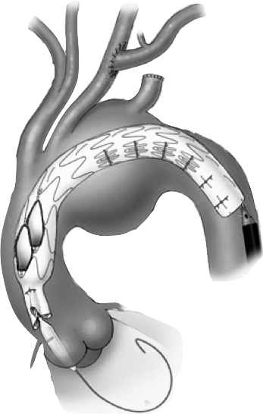
Disclosures
I do have the following relationship(s) with commercial interests.
 | Cook Medical | WL Gore | Endologix | Centerline Biomedical | ViTTA
Relationship | Research Support, Clinical Trials, Consulting | Clinical Trials, Consulting | Clinical Trials, Consulting | Consulting | Consulting, Clinical Trials
Received | Grants, honoraria | Honoraria | Honoraria | Stock | Honoraria
Notes:
Here are my disclosures

Slide 3
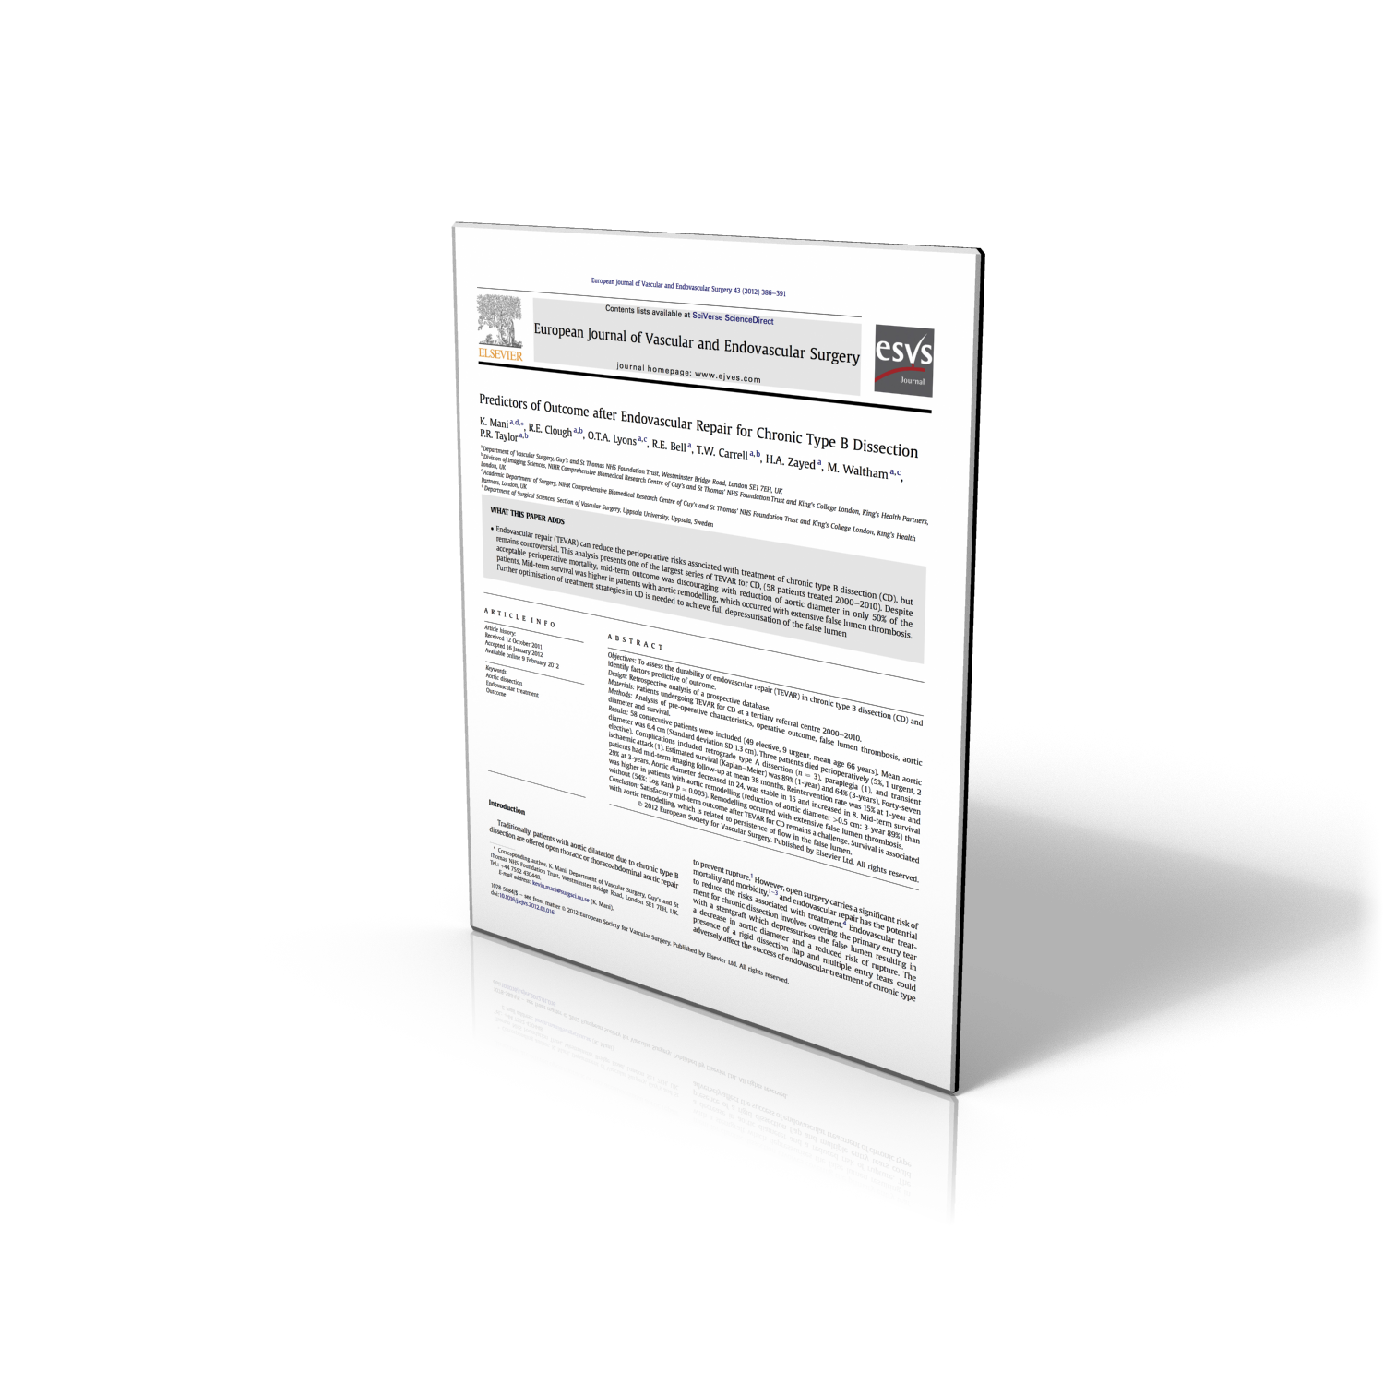
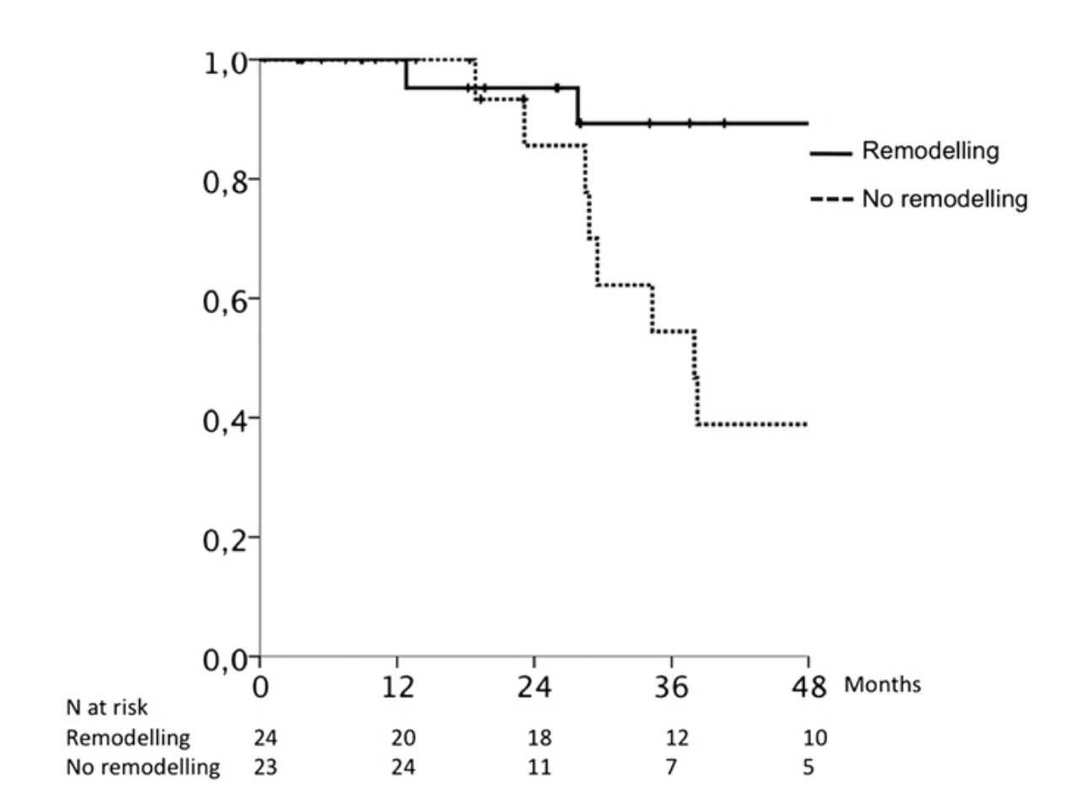
Outcome of TEVAR in cTBAD
Persistent FL Perfusion
1/3
Lack of Remodeling
Lack of Remodeling
Death
Death
Mani, K., et al. (2012). Predictors of outcome after endovascular repair for chronic type B dissection. EJVES 43(4), 386–391.
Notes:
Persistent perfusion of the false lumen has been linked to adverse outcomes in patients after TEVAR for Chronic type B dissections

Slide 4
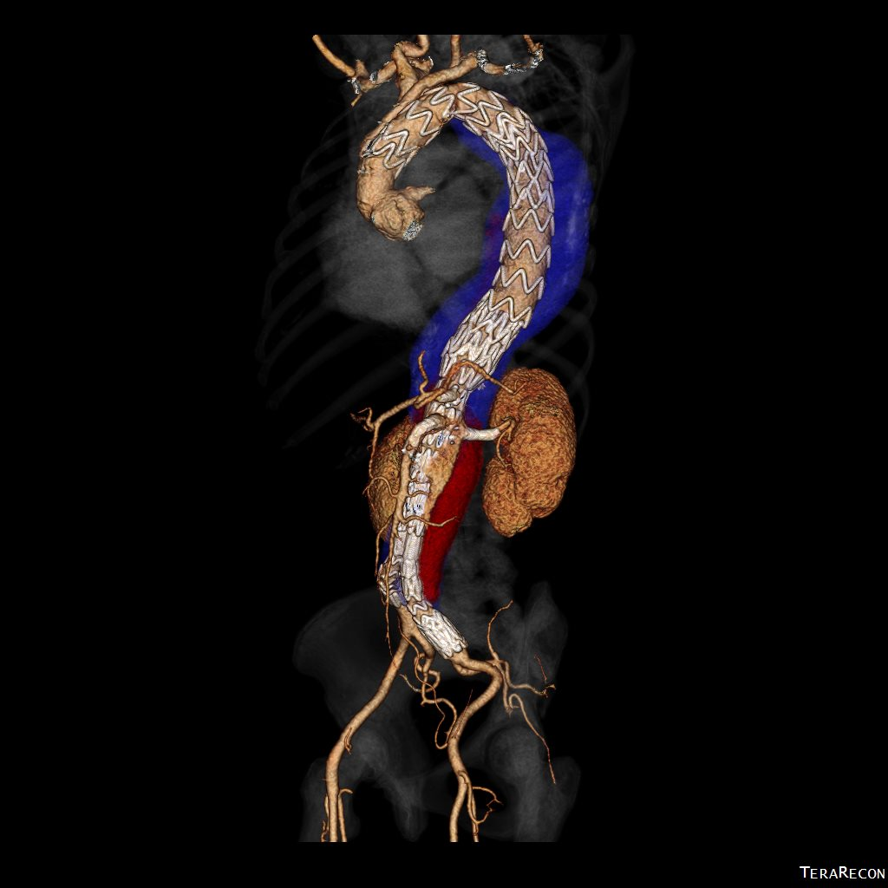
Do All Patients Need Treatment?
No good data on the outcome of persistent FL perfusion for FBEVAR
Is all FL Perfusion the same?
Distal target vessel fenestration perfusion
Perfusion from FL intercostal or lumbar vessels
Aortic or iliac entry tear communications
Notes:
There is however no data about the outcomes related to persistent false lumen perfusion after fenestrated or branched repair.
Additionally, We do not know if all false lumen perfusion is the same. Intercostal or lumber connections may behave differently than distal aortic or iliac reentry communications

Slide 5
Outcomes of endovascular repair of chronic post-dissection and degenerative thoracoabdominal aortic aneurysms using fenestrated-branched stent-grafts
Emanuel R. Tenorio, Gustavo S. Oderich, Mark A. Farber, Darren B. Schneider, Carlos H. Timaran, Andres Schanzer, Adam W. Beck and Matthew P. Sweet
Disclosures
ERT: none; GSO: consulting and research grants from Cook and WL Gore paid to Mayo Clinic; MAF: consulting and research grants from Cook, WL Gore, Endologix and Medtronic; DBS: consulting and research grants from Cook, WL Gore, Endologix and Medtronic; CHT: consulting and research grants from Cook; AS: consulting and research grants from Cook; AWB: none; MPS: none
Notes:
We have reported the outcomes of patients under going complex endovascular aortic repair for dissections in comparison to degenerative disease.

Slide 6
Aortic Research Consortium
University of
Massachusetts Andres Schanzer
University of Washington Matthew Sweet
Mayo Clinic Gustavo Oderich
Mass General
Hospital Matt Eagleton
Weill Cornell Medicine
NewYork-Presbyterian Darren B. Schneider
University of California
San Francisco
Tim Chuter
University of
North Carolina Mark A. Farber
University of Texas
South Western
Carlos H. Timaran
Surgical Associates
of Palm Beach
Country
Anthony Lee
University
of Alabama
Adam W. Beck
Notes:
The data was complied from seven sites participating in the Aortic Research Consortium in the US

Slide 7
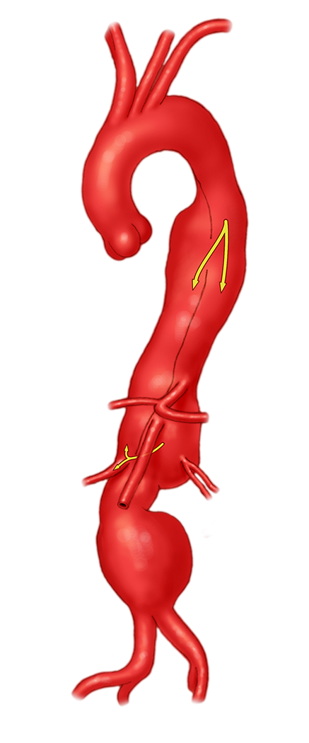
Patients
240 patients with Extent I to III TAAAs
190 (79%)
degenerative
50 (21%)
post-dissection
Notes:
There were 240 patients with Extent I to III TAAAs included in the study, 190 with degenerative aneurysms and 50 or 21% with chronic post-dissection aneurysms

Slide 8
Patient survival
89±5%
(79 – 100)
84±7
(70 – 99)
80±4
(74 – 86)
72±4
(64 – 82)
Survival (%)
Mean follow up was 14 ± 12 months
Degenerative
Post-dissection
P=.13
Follow-up (years)
At risk (no.)
190 83 40
50 26 15
Notes:
After a mean follow up of 14 months, there was no difference in patient survival, which was 84% for post-dissection and 72% for degenerative aneurysms at 2-years

Slide 9
Primary target vessel patency
97±1
(91 – 100)
95±2
(95 – 98)
Primary Patency (%)
Degenerative
Post-dissection
P=.93
Follow-up (years)
At risk (no.)
702 303 144
186 97 54
Notes:
At 2-years there was also no difference for primary target vessel patency, which was 97% for degenerative and 95% for PD aneurysms

Slide 10
Endoleaks
P=.001
P=.001
53
43
34
24
6
4
2
4
2
2
Degenerative TAAA
Post-Dissection TAAA
Notes:
We noted that the rate of endoleaks was higher for PD aneurysms, 53% vs 34%, predominantly due to higher rate of type II endoleaks or false lumen perfusion, 43% vs 24%.

Slide 11
Freedom from reintervention
77±4
(70 – 84)
?
72±8
(59 – 88)
Freedom from any Secondary Intervention (%)
Degenerative
Post-dissection
P=.23
Follow-up (months)
At risk (no.)
190 83 40
50 29 18
Notes:
At 2-years, there was no difference in freedom from reintervention, which was 77% for degenerative and 72% for PD aneurysms. The question remains how to manage patient’s with this problem after endovascular repair..

Slide 12
Aortic Occlusion Techniques
Candyplug utility
Knickerbocker device design technique
NOT applicable after FBEVAR
Notes:
While advanced endovascular techniques have been used after TEVAR to manage persistent false lumen perfusion, candy plug insertion or Knickerbocker device design is no longer applicable after FEVAR because there is limited false lumen access

Slide 13
Persistent False Lumen Perfusion
Perfusion from intercostals, lumbars and IMA
Similar to Type II endoleak
Managed when growth or persistence > 1 year exists
Trans-lumbar glue and/or coils
Perfusion from distal re-entry sites
Most commonly iliac
Managed by exclusion techniques and/or embolization
Notes:
We manage persistent perfusion of the false lumen in two different fashions depending upon the source of the perfusion.
For perfusion from side branch vessels such as the intercostals and lumbars arteries, our approach is similar to type II endoleaks for aneurysmal disease.
When perfusion persists and growth exists at one year, translumbar embolization with glue or coils is preferable.
False lumen perfusion involving distal reentry sites are typically managed with either exclusion techniques and/or embolization and most commonly occur in the iliac or femoral vessels.

Slide 14
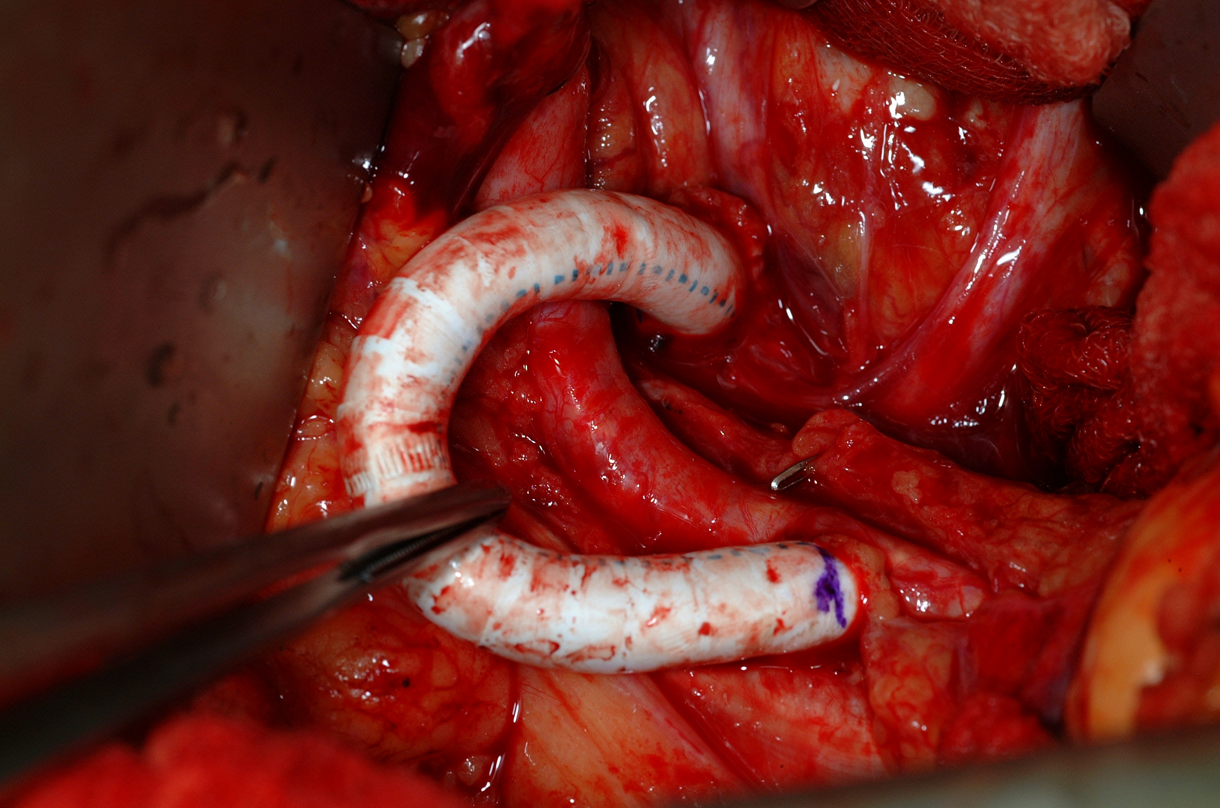
Exclusion Options
Management can be obtained thru several methods
Surgical iliac reconstruction to exclude FL perfusion
Maintain hypogastric perfusion to decrease spinal cord ischemia risks
Preservation of hypogastric perfusion via
Focal re-entry exclusion
Iliac branch device
Fenestrated limb device
Embolization of the FL in the CIA or EIA segment
Ext iliac to Hypo Bypass
Notes:
There are several options when it comes to re-entry exclusion including surgical iliac reconstruction. It is important to maintain hypogastric perfusion to decrease the risk of developing spinal cord ischemia.
Internal iliac patency can also be maintained endovascularly with stent graft options including iliac branched devices or fenestrated limbs. In some cases, simple false lumen embolization of the involved iliac segment is adequate.

Slide 15
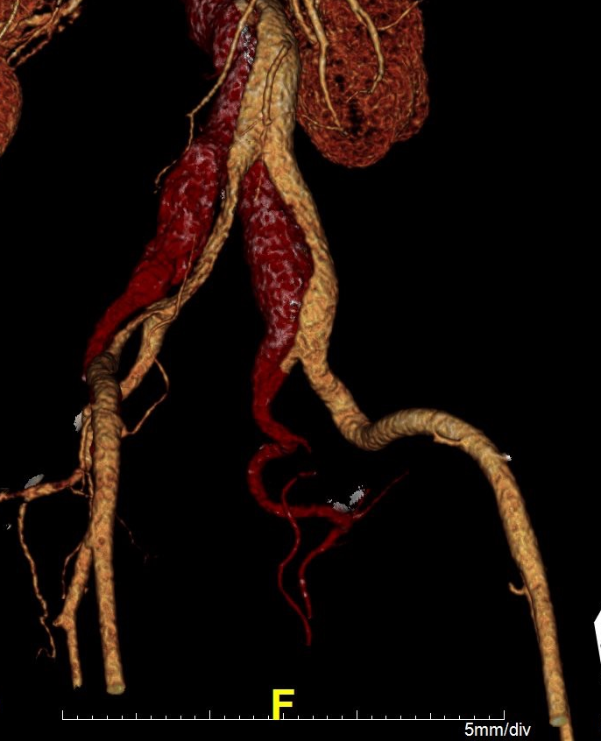
Iliac Connections
R Ext. Iliac
L Hypogastric
Notes:
In this case the patient had bilateral distal communications in the Right external iliac and left hypogastric regions

Slide 16
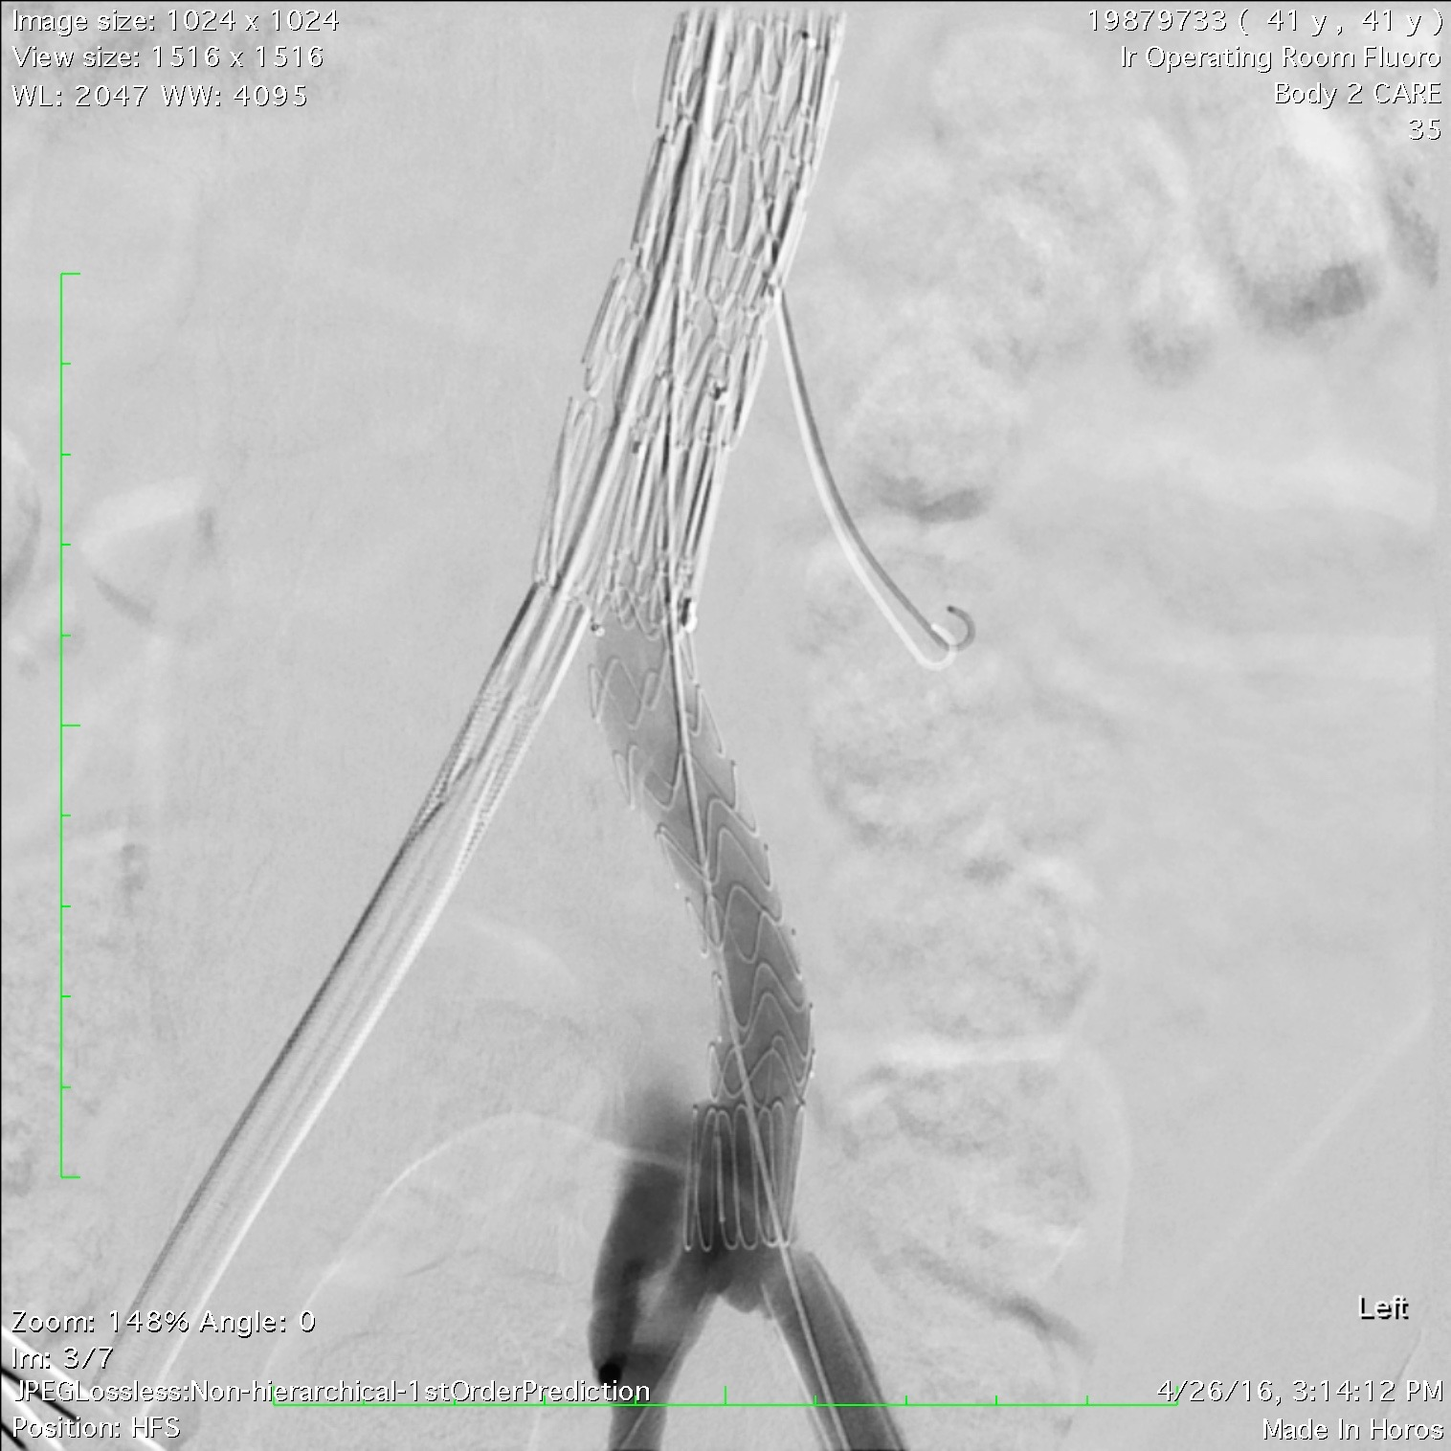
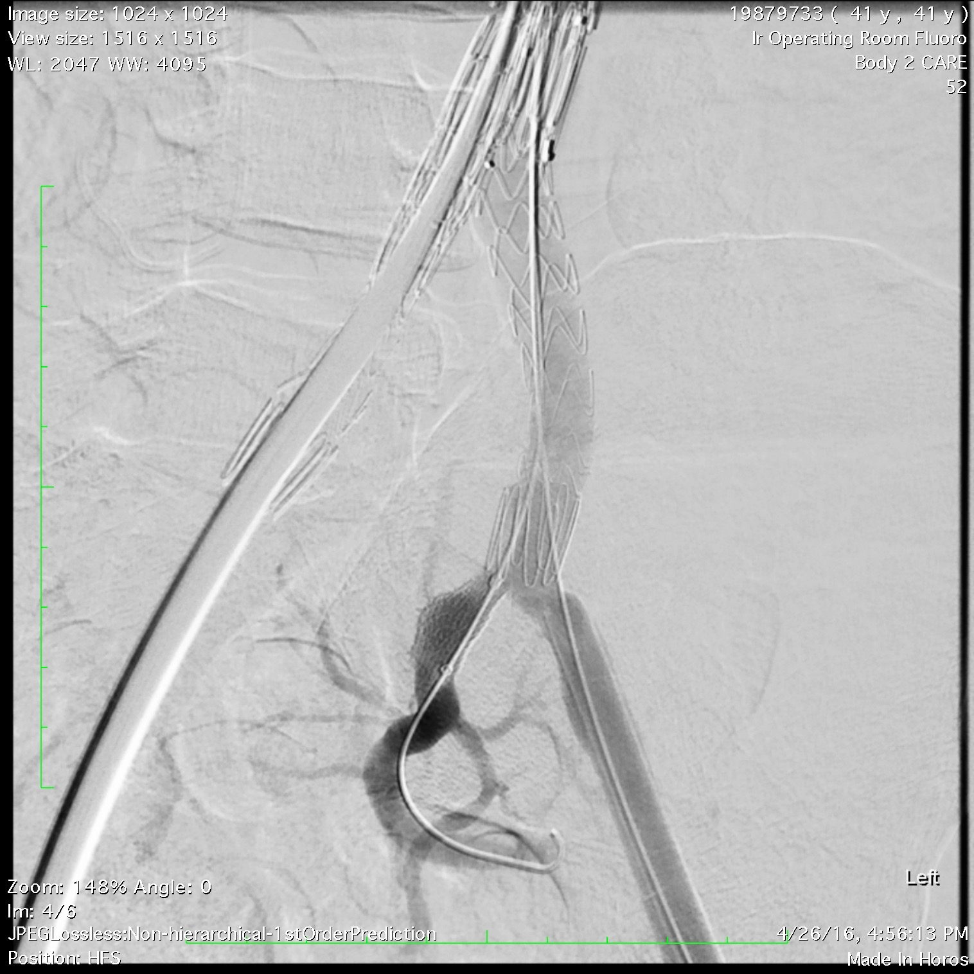
Focal Re-entry Exclusion
Hypogastric Management
Viabahn 11 x 2.5 cm
Re-entry tear in the left hypo
Notes:
Exclusion was obtained in the left hypogastric by placing a stent -graft into the internal iliac artery, excluding the connection.

Slide 17
Completion CT Scan
REI communication thru epigastric
Notes:
This excluded the re-entry tear on the left side however there was still false lumen perfusion on the right from communication thru the epigastric artery into the false lumen in the right iliac system

Slide 18
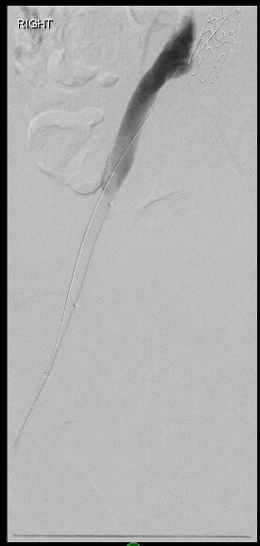
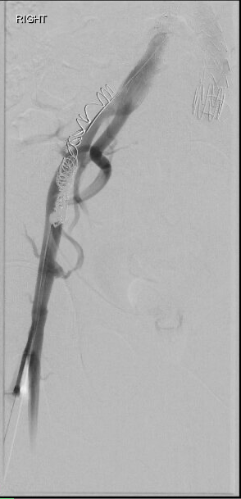
REI FL Coil Embolization
FL Angio
FL Access thru epigastric
Coil Embolization
REI
Notes:
This was managed by percutaneous distal common femoral artery access and coil embolization theu the epigastric re-entry site of the external iliac artery false lumen

Slide 19
Successful R EI coil embolization thru epigastric connection
Notes:
By managing both regions complete exclusion was accomplished.

Slide 20
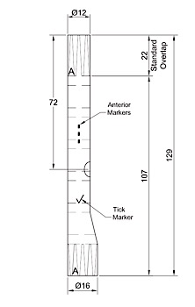
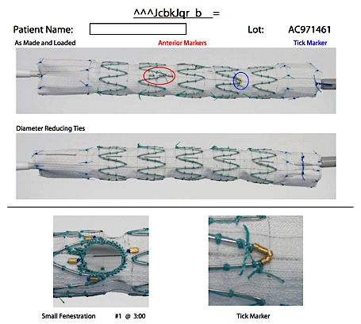
Fenestrated Limb for Hypogastric Perfusion
Notes:
In some cases, a custom manufactured iliac fenestrated limb can be designed to maintain hypogastric flow and exclude the re-entry area

Slide 21
Fenestrated Limb for Hypogastric Perfusion
Re-entry opposite from hypogastric origin
Notes:
This is used when the re-entry tear is just opposite the take of of the hypogastric artery as in this case. This is particularly helpful when there is not enough luminal space for the safe implantation of an iliac branched device.

Slide 22
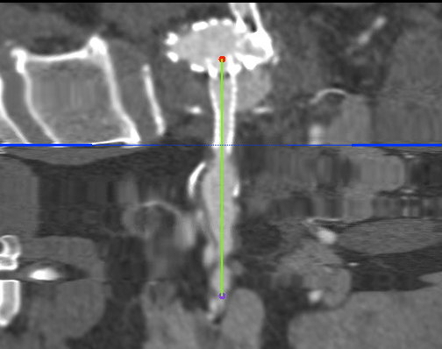
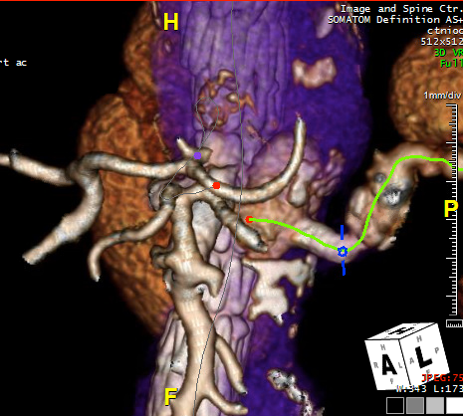
Conservative Management
In SOME circumstances when there is no growth and exclusion has potential consequences… observation may be warranted
Communicates with FL
Dissection
Notes:
Lastly, there are some false lumen connections that are best managed conservatively. In these images, the chromic dissection has extended out into the left renal artery. The connection communicates retrograde into the false lumen as seen here. While false lumen perfusion is present, it has not lead to any increase the aortic size. In these cases, if treatment is required, it may be best to approach the false lumen from a trans -umbar position and coil embolization of the connection along side of the left renal artery stent graft.

Slide 23
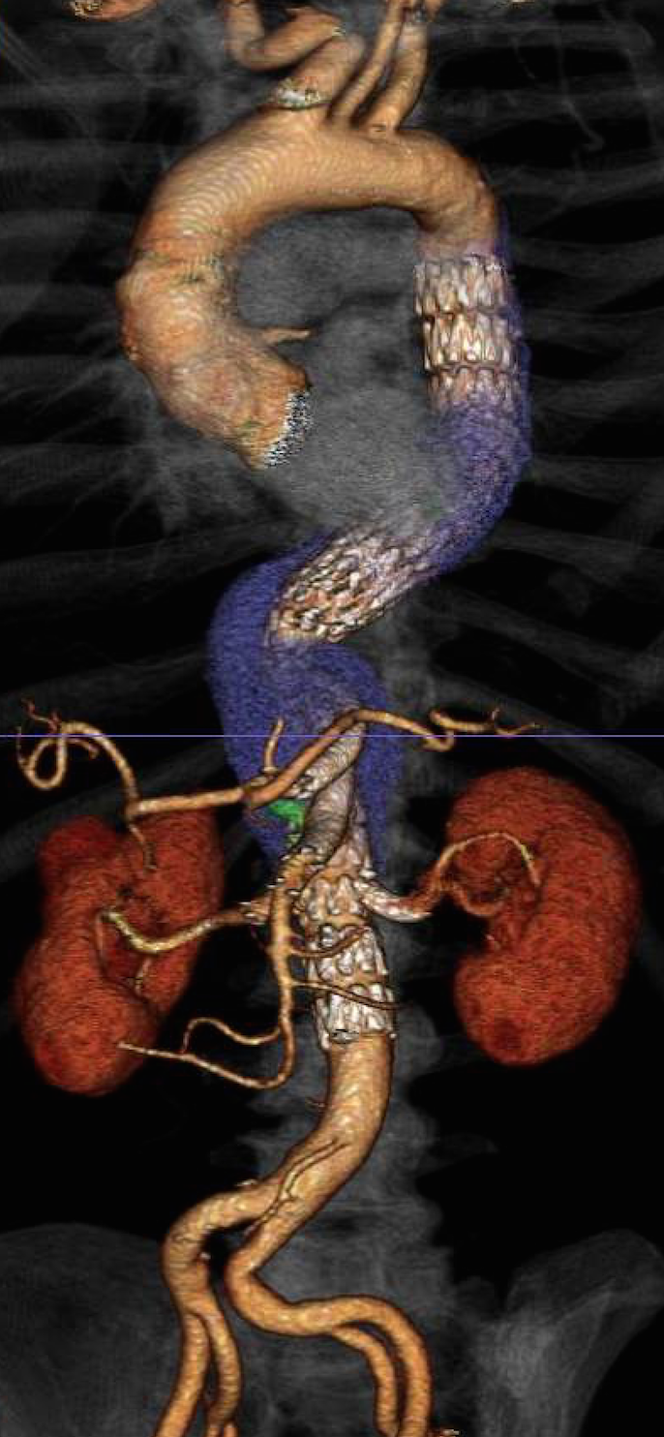
Conclusion
Persistent false lumen perfusion is present in a significant number of patients after FBEVAR for post-dissection aneurysmal degeneration
Management strategies should be targeted at exclusion of re-entry sites with stent-grafts or coil embolization
In certain situations conservative management may be indicated.
Notes:
READ

